Slide 1

Costa Rica

Slide 2
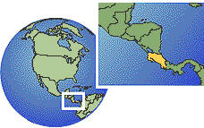
Notes:
Costa Rica is located in Central America, a region midway between North and South America.
Costa Rica is bordered by Nicaragua to the north and Panama to the south. It’s western border is the Pacific Ocean and it’s eastern border is the Caribbean Sea.
Costa Rica is a small country, about 76 miles at it’s narrowest point and 172 miles across at its widest point. It is 288 miles from north to south. It is the second smallest country in Latin America
In 2009 Costa Rica was named the happiest country among all Americas (Northern, Central, and Southern).

Slide 3
Costa Rican Flag
Notes:
Each color represents important aspects of Costa Rica:
Blue means the sky, opportunities at reach, intellectual thinking, perseverance to accomplish a goal, infinite, eternity, and ideals of the religious and spiritual desires.
White means clear thinking, happiness, wisdom, power and beauty of the sky, the driving force of initiatives to search for new endeavors, and the peace of Costa Rica.
Red means the warmth of Costa Rican people, their love to live, their blood shed for freedom, and their generous attitude.
National Shield:
"America Central" (Central America) is imprinted in silver letters on the blue ribbon at the top of the coat-of-arms. The two branches of myrtle closing the coat-of-arms represent the peace of Costa Rica. On the white ribbon that joins the branches, the title "Republica de Costa Rica" (Republic of Costa Rica) is imprinted in golden letters. The seven stars above the volcanoes represent the seven provinces of Costa Rica: Alajuela, Cartago , Guanacaste, Heredia, Limon, Puntarenas, and San Jose.
The volcanoes represent the three Costa Rica's mountain range systems. They form a valley and divide the country in two parts. The two oceans represent the Atlantic and Pacific oceans. The merchant ships sailing on each ocean represent the cultural and commercial exchange between Costa Rica and the rest of the world. The rising sun represents the prosperity of Costa Rica.
The small circles on both sides of the coat represent the coffee beans, "Golden Beans.“
Unofficial Motto: "Pura Vida."- the words convey the state of happiness, peace, and tranquility that the political stability and freedom bring to Costa Ricans.
The phrase actually comes from a 1956 Mexican movie, "Pura Vida!" By 1970 Costa Ricans were using the expression on a daily basis. The expression "Pura Vida" has become so popular that has been added to Costa Rican Spanish dictionaries as an idiom to greet, or to show appreciation.
At 7:00 am in the morning every radio station forecast a national anthem and then the most important news and announcements for the day.

Slide 4
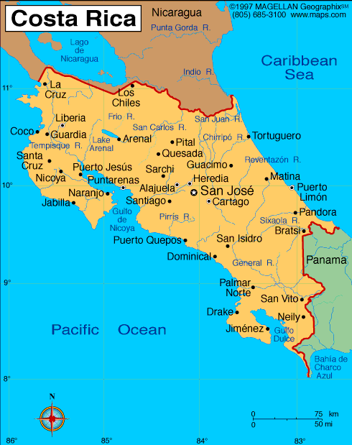
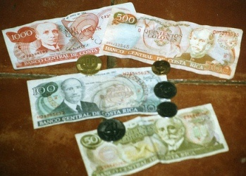
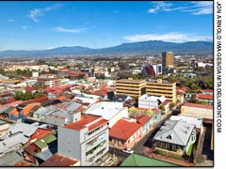
Costa Rica
Capital: San Jose
Language: Spanish
Currency: Colón
Population: 4, 253,877
Climate: tropical and subtropical; dry season (December to April); rainy season (May to November); cooler in highlands
Notes:
It’s divided into 7 provinces, the capital is San Jose in the central valley and its largest city. San Jose is home to about half of the population of Costa Rica.
96% literacy rate
¾ population Roman Catholic
Ethnicity: White – 94%, 3% black, Amerindian 1%, Chinese 1%, Other 1%
Just elected first woman president of Costa Rica, Laura Chinchilla
2 seasons, winter (May-June thru November) and summer (December through April-May). Almost all rainfall happens during the winter months
1821:
Costa Rica gains its independence from Spain and joins the Mexican Empire.
1823:
The Mexican Empire dissolves; Costa Rica joins El Salvador, Guatemala, Honduras and Nicaragua as the United Provinces of Central America.
1838:
Costa Rica becomes a fully independent country.

Slide 5
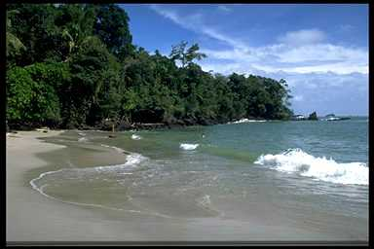
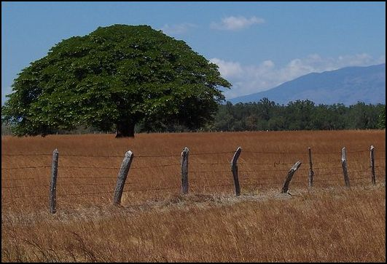
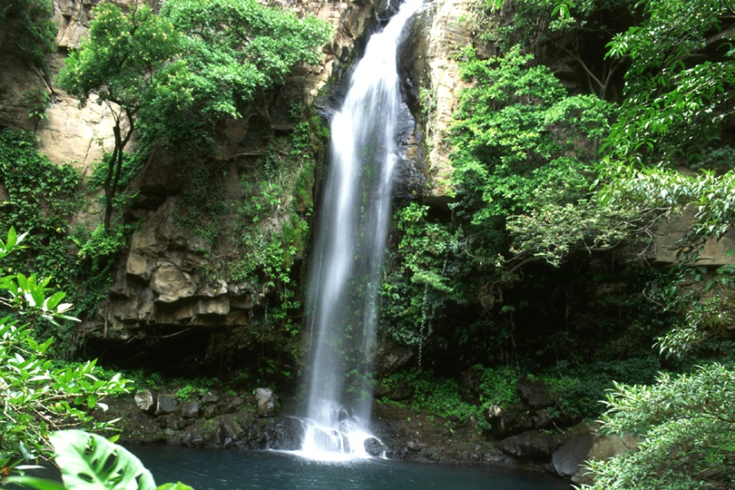
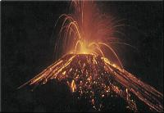
Geography of Costa Rica
Over 100 Volcanoes | Beaches
Rain forests | Central Plains
Notes:
Over 100 volcanoes in Costa Rica, 4 of them considered “active”. The last major eruption happened in the 60s and the latest activity was recorded in 2000 from Volcano Arenal (pictured here).
coastal plains separated by rugged mountains including over 100 volcanic cones, of which several are major volcanoes. 4 major volcanoes near capital, last major eruptions in 1960s.

Slide 6
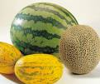
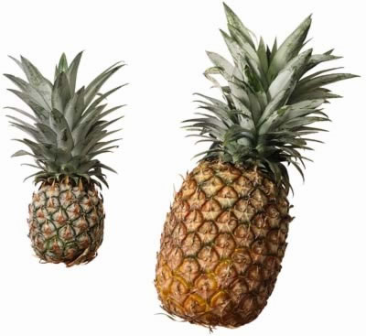
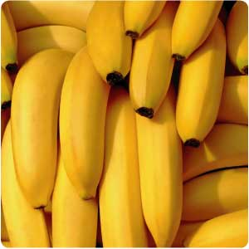
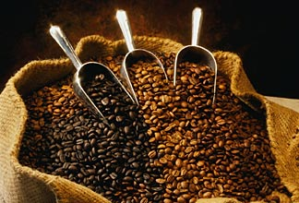
Notes:
Top exports used to be bananas and coffee but recently pineapples have surpassed coffee as the second highest export of agricultural products from CR. Costa Rica is the 3rd largest exporter of melons in the world.
Other things that are grown and exported from Costa Rica include sugar, corn, rice, beans, beef and ornamental plants.

Slide 7
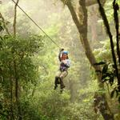

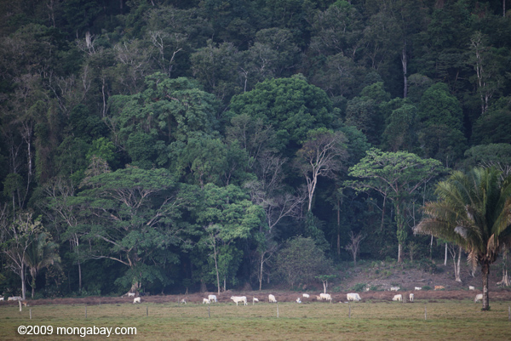
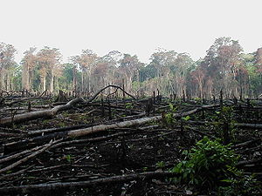
Notes:
Tourism (eco-tourism) has surpassed both banana and coffee exports and foreign revenue-source for Costa Rica and is the second largest industry in terms of input to the economy.
Electronic parts (Intel has a large facility in Costa Rica) is the #1 industry in Costa Rica. Healthcare products is also an important industry in CR.

Slide 8
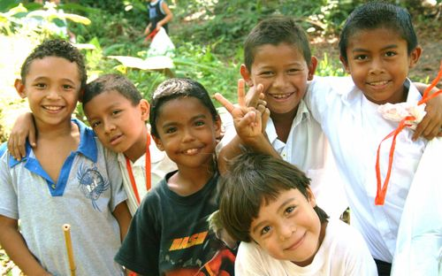
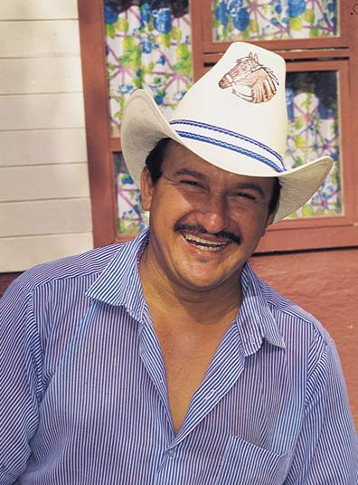
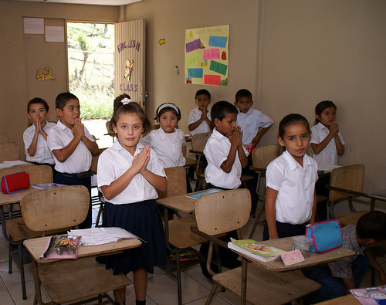
Notes:
96% literacy rate in CR.
Costa Rica was one of the first countries in the world to make education free and required for all children
Ticos is the collective common name that Costa Ricans cell themselves. More specifically, a Tica is a female Costa Rican and a Tico is a male.
The name comes from a preference Ticos have of using the diminutive in their speech. By diminutive, I mean they change everything so it means 'little something'. For instance, a Tico might call his grandmother (abuela), abuelita, or her house (casa) her casita. A kiss (beso) becomes a besito! This goes on and on and covers almost everything. In fact, it makes learning Costa Rica style Spanish a bit harder as you have to learn these diminutives even if you don't use them. So why Tico? Because many people pronounced the diminutive saying momentito (meaning just a short moment), as "momentico". I seldom hear the old ...ico thing any more, but the ...ito or ...ita thing is alive and well

Slide 9
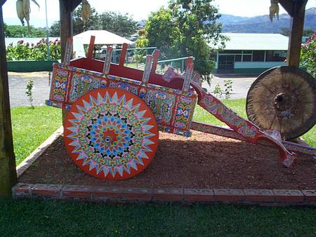
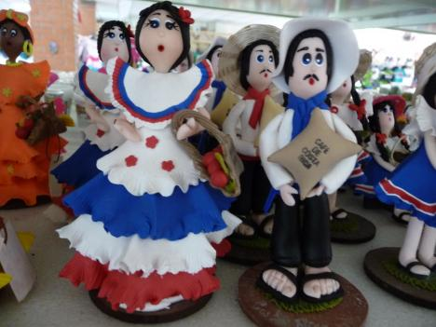
Notes:
The oxcart is an important part of CR’s history and economic development. Prior to modern transportation methods, the oxcart was used to transport coffee beans and other crops to the ports for shipment overseas and bring imported goods into the interior of the country. Today they are a cultural symbol of CRs past.
Tico and Tica wearing traditional Costa Rican costume.

Slide 10
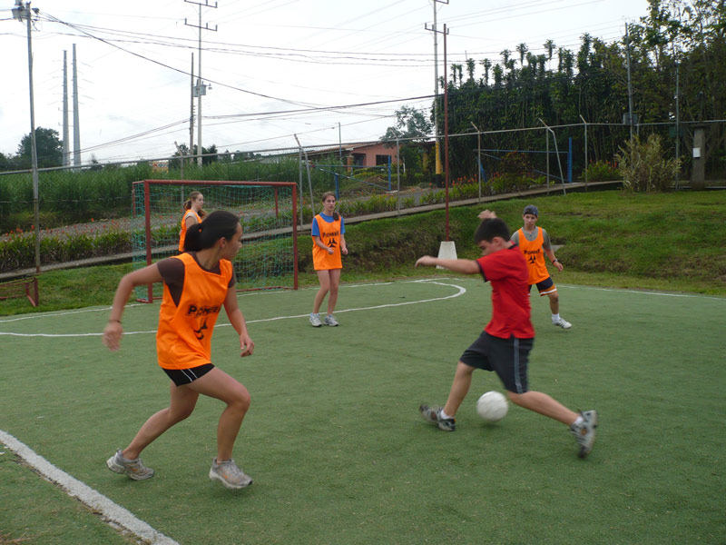
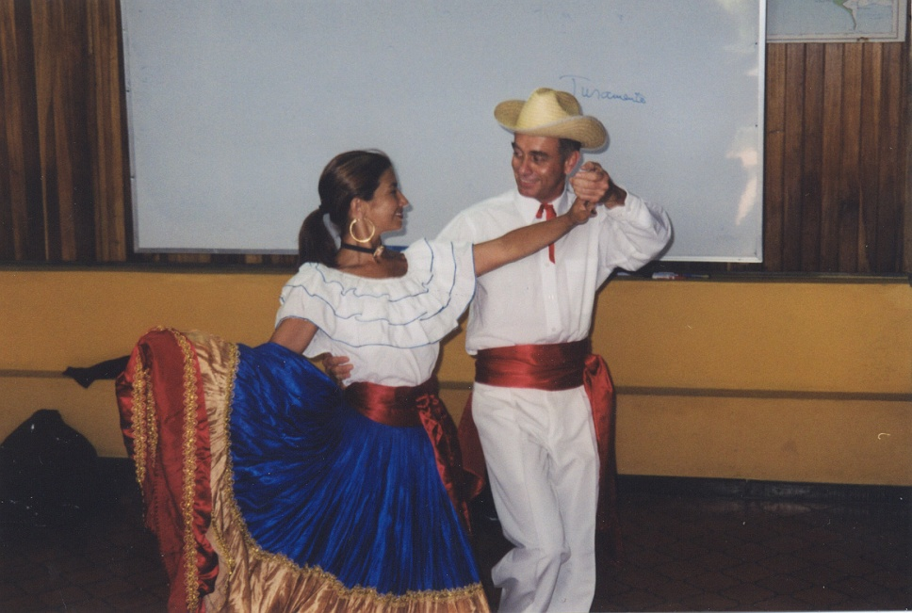
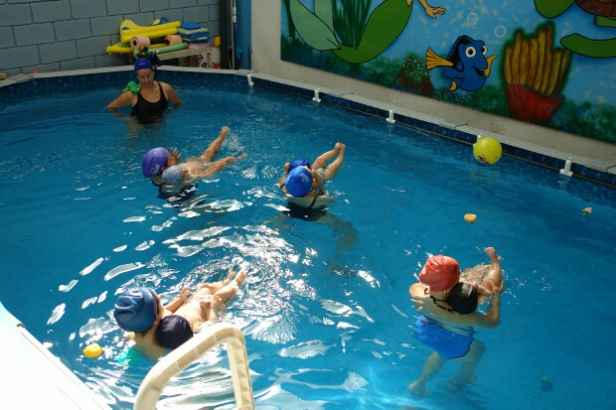
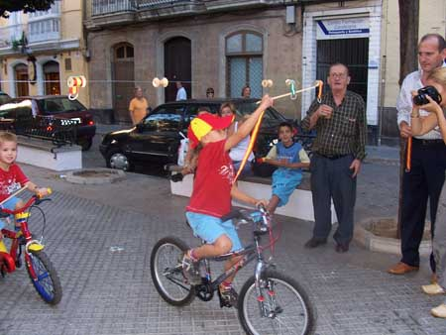
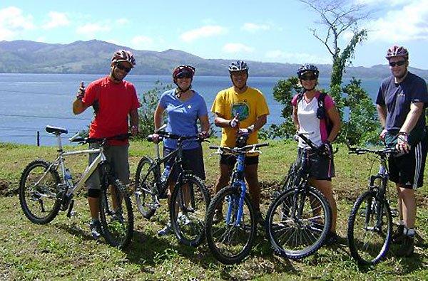
Popular Sports and Activities
Notes:
In the carrera de cintas, short belts with loops on one end are hung from a wire suspended between two posts. Contestants, who may be on either horses or bicycles, ride towards the wire and attempt to capture a belt by putting a peg through the loop.

Slide 11
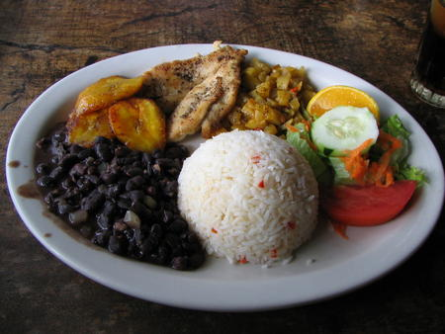
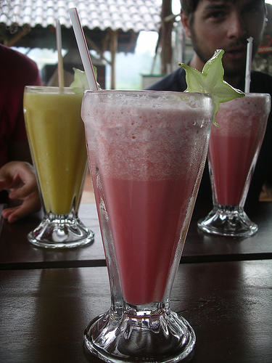
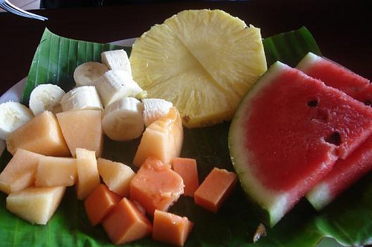
Costa Rican Foods
Notes:
Costa Rican cuisine does not have distinct or original styles to call its own. It is a combination of Spanish, Mexican, American, Caribbean and Southern American influences. This style of cuisine is shared by most of Central America, although local variations have appeared in each of the country.
The closest thing to a national dish is Gallo Pinto ("spotted rooster", although the name has no relation to the ingredients). It is mainly a combination of black beans and white rice (usually from the day before), and it is spiced with cilantro, onions, garlic, salt and a local condiment called Salsa Lizano. It is typically eaten at breakfast with eggs, meat, and/or natilla (sour cream). Fried plantains and either corn tortillas or bread, are also common.
Most meals in Costa Rica are very similar. Rice and beans are the basis of many Costa Rican meals. Gallo Pinto, the national dish of fried rice and black beans, is predominantly served as a breakfast. At lunch Gallo Pinto becomes Casado: rice and beans enhanced with cabbage and tomato salad, fried platains, and meat. At dinnertime chicken or beef is added to this meal.
Fresco de Frutas – made with either water or milk and your choice of fruit.
MacDonald's, Burger King and all the others have HOME DELIVERY in Costa Rica! This is not a good thing if you are on a diet.

Slide 12
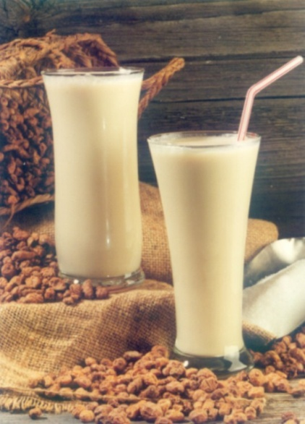
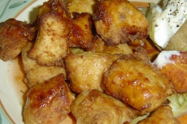
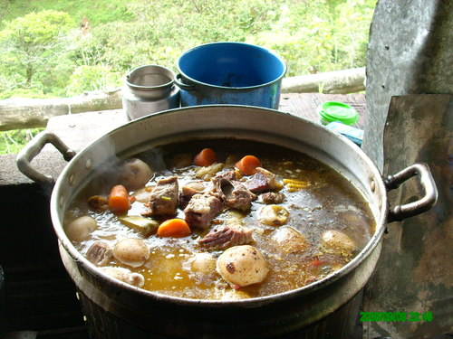
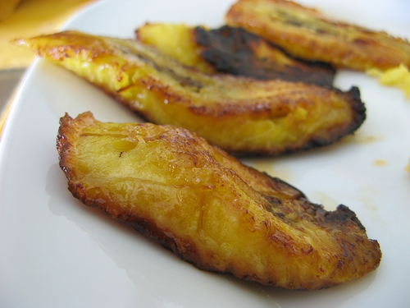
Horchata
Chicharrones
Olla de Carne
Fried Plantain
Notes:
Horchata – cinnamon flavored drink made from cornmeal
Chicharrones – deep fried pig skin
Olla de Carne – beef stew or other typical soup dishes
Another typical Tico dish is olla de carne (meat pot), a nourishing stew that consists of a small portion of beef and many vegetable common to the region: nampi and camote, both belonging to the sweet potato family, chayote (water squash), potatoes, and carrots and as per every meal, served with rice. There’s also olla podrida, another Costa Rican favorite. This stew owes its distinct flavor to the vegetables used in it: yucca, green plantain, sweet potato, tannia, tacacos, taro, pumpkin, carrot, cho-cho, onion, cabbage, and whatever else the cook deems worthy.

Slide 13
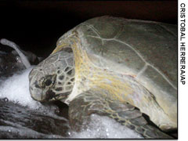
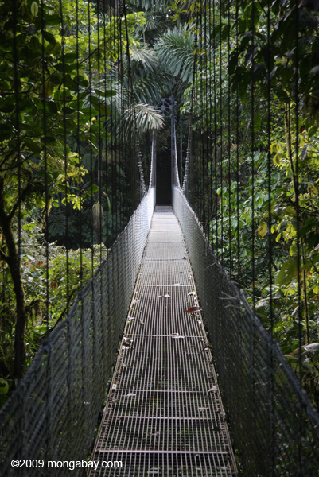
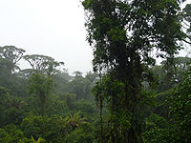
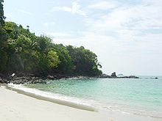
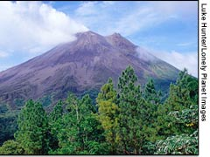
Notes:
26 National Parks and 160 protected areas that comprise ¼ of Costa Rica. 4.5% of world’s biological species found in Costa Rica.
Tortuguero National Park: Tortuguero is one of the Costa Rica's most popular national parks (3rd most visited nat’l park even though accessible by boat or plane only). It was created in 1975, as a refuge for nesting sea turtles. The park protects 22 miles of beach for turtles to lay their eggs away from poachers. Four out of seven of the known types of sea turtles in the world nest in Tortuguero. Tropical climate, is very humid and receives an average of 250 inches or rain annually.
Monteverde Cloud Forest Reserve – Largest number of orchids in the world. Popular destination for ecotourism
Manuel Antonio Nat’l Park – smallest nat’l park in CR but second visited park. Beautiful beaches with many different animal species to see (sloths, birds, 3 of the 4 kinds of monkeys, bats, snakes, iguanas, etc.). But, visitors must vacate the park by 4pm each day to allow for crocodiles to return to the area each evening!

Slide 14
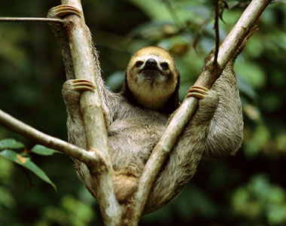
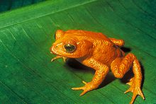
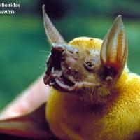
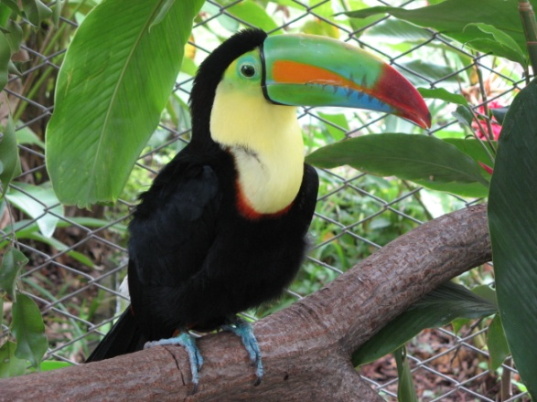

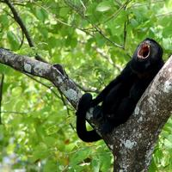
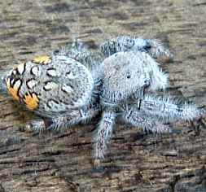
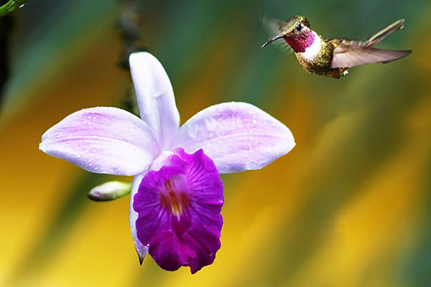

750,000!!
20,000!!
52 different hummingbirds
Notes:
200 mammal species in Costa Rica, 100 of which are bats.
There are about 52 species of hummingbirds in Costa Rica, making Costa Rica a true North American hummingbird capitol.
Monkeys are one of the most common mammals in Costa Rica – next to bats. There are about four common species of monkeys in Costa Rica, including the Howler money, Spider money, white-faced capuchin, and the squirrel monkey. Most monkeys live in groups of 10 to 40 with other animals.
A young three-toed sloth dangles languidly from vines in Osa Peninsula. Solitary, arboreal, and nocturnal creatures, sloths use their long, prominent claws for climbing around the rain forest canopies of Central and South America. The world’s slowest mammals, sloths spend an average of 18 hours a day sleeping and are most active from dusk until dawn.
Bug-phobists look out! There are about 750,000 species of insects that live in Costa Rica, including about 20,000 different types of spiders!
Costa Rica has more than 1,250 types of butterflies. That's about 10% of all known butterfly species. Farms in Costa Rica breed the insects and sell them to zoos.
850 species of birds with 52 different hummingbird species, 1,000 species of butterflies, 220 species of reptiles, 9,000 species of plants, and 34,000 species of insects, the majority of which are spiders (20,000)!

