Slide 1
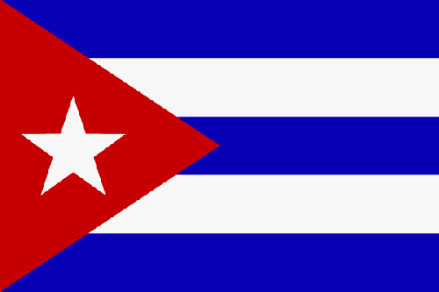
Cuba
Notes:
The flag was created during the fight for independence from Spain. Blue stands for Cuba’s three regions, white for purity, and red for soldiers’ blood.

Slide 2
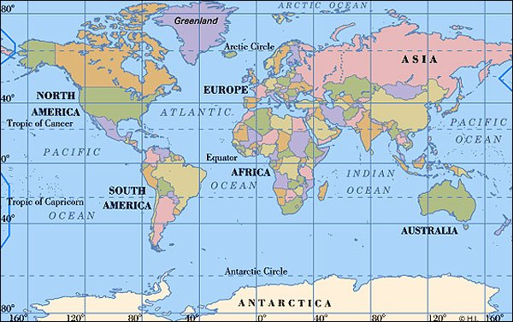
On which continent is Cuba?
North America

Slide 3
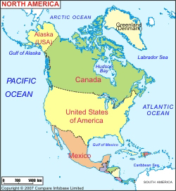
Where in
North America?

Slide 4
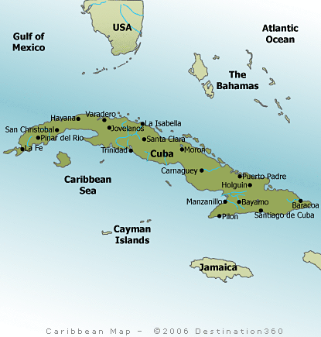
Population 11.4 million people
(around 2X of WA state)
Capital – Havana
Language – Spanish
Size - 42427 sq mi
(about ½ of WA)
Money – Pesos
Imports – Food, petroleum, chemicals, machinery
Exports – Sugar, Tobacco, Coffee
Notes:
Money - The Cuban government decides what is grown, sold, and made in the country. It also decides how much things cost and how much money everyone earns. Many Cubans earn their pesos (Cuban money) by working with all the tourists who come for Cuba’s beautiful beaches, music, and culture. Others earn money farming crops like sugarcane, tobacco, fruit, and coffee. The economy is also dependent on money that is sent home by Cubans living outside the country, especially by those living in the United States.

Slide 5
Notes:
Close to USA (95 miles to the tip of Key West). Many Cubans try to escape Cuba by taking boats to USA. Many die in the attempt.

Slide 6
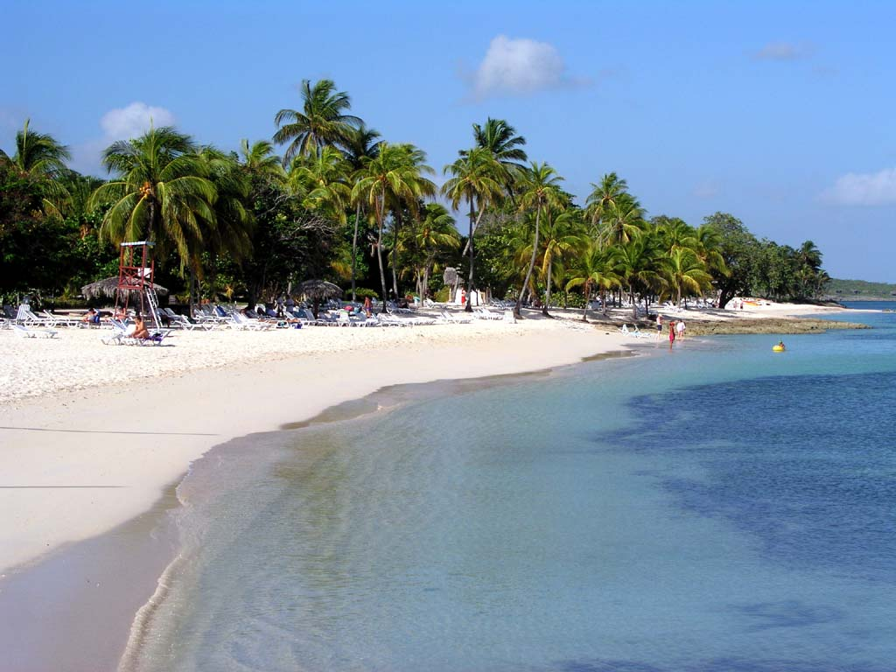
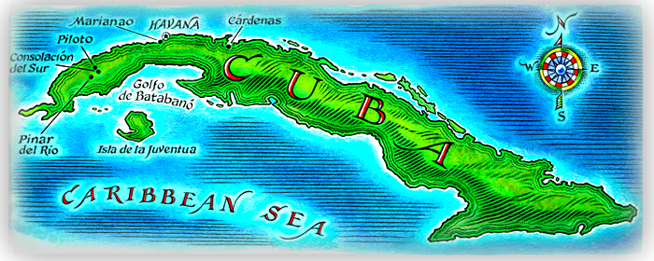
Landscape
Notes:
Cuba isn’t just one island. It has two main islands, Cuba and Isla de la Juventud (Isle of Youth), and more than a thousand smaller islands. Mountain ranges cut the country into three areas: tropical rain forests in the east, flat prairies in the center, and hills and valleys in the west. But no matter where you are in Cuba, it’s almost always hot and humid. Instead of a winter or summer, Cuba has dry and rainy seasons. Hurricanes sometimes come during the rainy season, from May to October.

Slide 7
History
Notes:
1492 Christopher Columbus arrives on the island
1511 Spain begins to conquer Cuba
1535 The native peoples are almost completely wiped out from disease and war
1762 Britain captures Cuba from Spain and trades it a year later for Florida
1868–78 The people seek independence from Spain in the Ten Years’ War, but they are defeated
1898 The United States defeats Spain in the Spanish-American War and wins Cuba
1902 The U.S. officials leave and Cuba gains independence
1952 Fulgencio Batista overthrows the government and rules as a dictator
1958 Fidel Castro and his rebels overthrow Batista
1961 The United States trains Cubans to overthrow Castro’s government in an operation called the Bay of Pigs; the operation fails
1962 The Cuban Missile Crisis brings the United States and Soviet Union close to a nuclear war
2003 The Cuban government jails 75 dissidents (people who disagree with the government), drawing international criticism
2006 Because of health problems, Castro temporarily hands over control of the government to his brother, Raul
2008 After nearly 50 years as the leader of Cuba, Fidel Castro resigns the presidency due to failing health

Slide 8
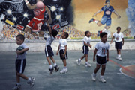
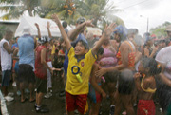
Life as a Kid
Notes:
When they aren’t in school, Cuban kids play sports or games like tag, leapfrog, hide-and-seek, and Cuba and Spain (a war game) with their friends. Boys play chess and marbles, and girls play with dolls. Most kids like to dance at festivals and parties. At home, children have a variety of chores to do. Girls help clean the floor, cook, and wash clothes. Boys often run errands to the store or bakery. Kids in the countryside have chores on the farm.
Education is very important to Cubans. Kids start school when they are five and have to go until they are at least twelve. They attend classes Monday through Saturday and have homework most nights. Boys wear red pants, white shirts, and a red or blue neckerchief (a square of cloth worn around the neck). Girls wear red skirts, white blouses, and a neckerchief. Sunday is the favorite day of the week because kids can relax and play.
It wouldn’t be a meal in Cuba without rice, beans, and bread. Dinner usually includes sweet potatoes, plantains (a fruit similar to bananas), and tomatoes. Meat is a favorite, but it is so expensive that many families eat fish instead. Many fruits are available, like mangoes, avocados, guavas, oranges, lemons, pineapples, and papaya. Favorite desserts include cake, ice cream, and cookies. At the table, kids are expected to behave well and avoid talking too loudly.

Slide 9
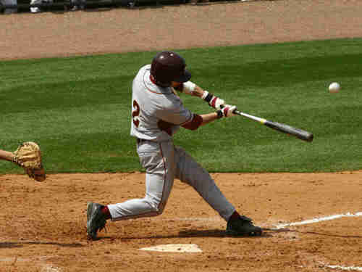
Sports
Notes:
In sports, baseball is Cuba’s first love. Boys start playing in leagues before they are seven, and they play for fun whenever they can. Many good U.S. baseball players, such as the Yankee’s Orlando Hernandez and the Red’s Tony Perez, were born in Cuba. Cuba also has a professional league. Girls play sports in school, but women generally don’t play sports. Kids also enjoy basketball, soccer, volleyball, and other sports. Many kids enjoy riding their bicycles.

Slide 10
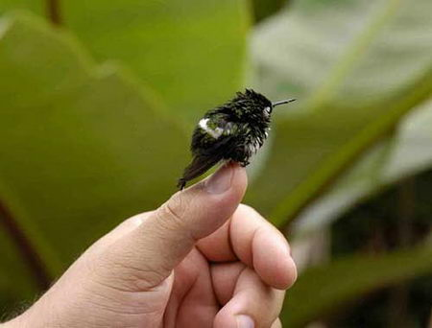
Animals
Bee Hummingbird
Notes:
Bee hummingbirds are about 2 1/4 inches in length and weigh 0.07 ounces. They are a homeothermic vertebrate (warm-blooded). Their body temperature is about 104 degrees. Bee hummingbirds have the second-fastest heart rate of all animals. They are likely to be mistaken for bees because of their size. Their wings beat 80 times per minute normally and as much as 200 times per minute when courting. Female bee hummingbirds lay two eggs the size of an adult's smallest fingernail. Their nests are 3 centimeters in diameter.
To maintain their high energy requirement, bee hummingbirds will eat half their total body mass and drink eight times their body mass every day. Their diet is mainly small insects and nectar.

Slide 11
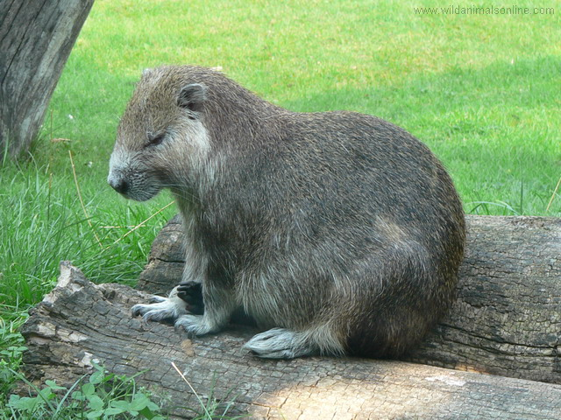
Cuban Hutia
Notes:
Cubas largest land mammal.
They have a head and body length of 18 to 35 inches (46 to 90 centimeters), a tail length of 6 to 12 inches (15.2 to 30 centimeters) and a weight of 6.6 to 18.7 pounds (3 to 8.5 kilograms). They have short, stocky legs and "waddle" when they move. Their feet are broad and each foot has five toes with prominent claws.
They have thick, coarse fur and on the upper body, which can be various shades of black, gray, brown, red, yellow, and cream. Their underside fur is usually softer and a lighter shade.
Habitat: Their habitat includes tropical rainforest, mangrove forests, marshy areas, scrubland, and the mountains of eastern Cuba.
The Cuban hutia uses its strong claws to climb trees. (Frank W. Lane/FLPA—Images of Nature. Reproduced by permission.)
Diet: Cuban hutias are omnivores, meaning they eat both plants and flesh, but eat mostly plants. Their diet includes leaves, fruit, bark, lizards, and small animals.
Cuban hutias are hunted by humans for their meat. In some areas of Cuba they are in such abundance that they are considered an agricultural pest by farmers.

Slide 12
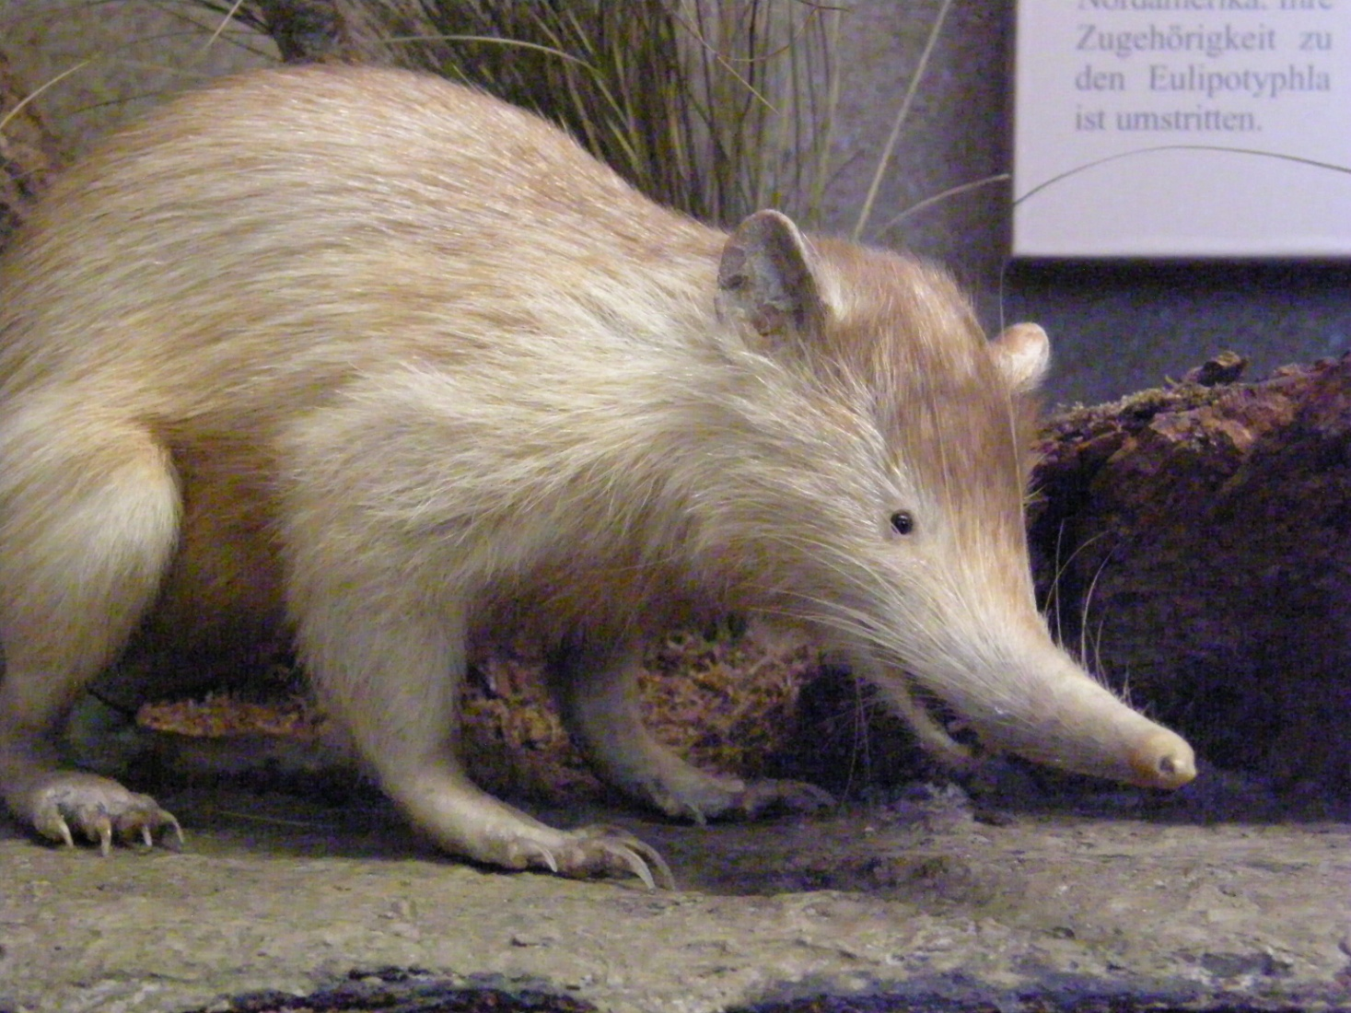
Solenodon
Notes:
Between 28–32 centimetres (11–13 inches) long from nose to rump, and weighing between 700–1,000 grams (25–35 oz),^{[4]} solenodons are known to become very easily agitated and may squeal or bite with little or no provocation.
The Cuban solendon is an endangered species that spends most of the day in trees or hiding under rocks or brush.
Solenodons have a few intriguing traits, two of them being the position of the two teats on the female, almost on the buttocks of the animal, and the second being the venomous saliva that flows from modified salivary glands in the mandible through grooves on the second lower incisors ("solenodon" derives from the Greek "grooved tooth"). Solenodons are among a handful of venomous mammals.
The diet of solenodons consists largely of insects, earthworms, and other invertebrates, but they also eat vertebrate carrion, and perhaps even some living vertebrate prey such as small reptiles or amphibians

Slide 13
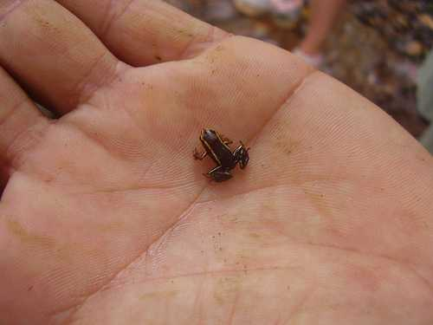
Monte Iberia dwarf eleuth
Notes:
At 9.6 to 9.8 millimeters long, the Monte Iberia Eleuth and the Brazilian Gold Frog are tied as the smallest frog, amphibian or tetrapod. The Monte Iberia Eleuth was first discovered in 1996 on Mount Iberia, from which the animal gets its name, and exists in only two small regions of Cuba. Much remains unknown about this small creature.

Slide 14
El Fin

Slide 15
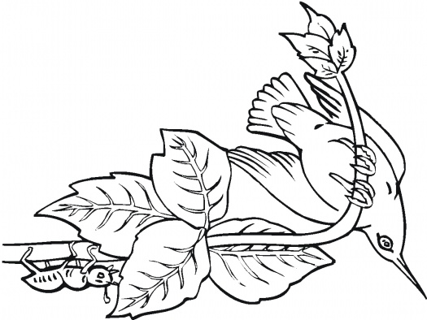
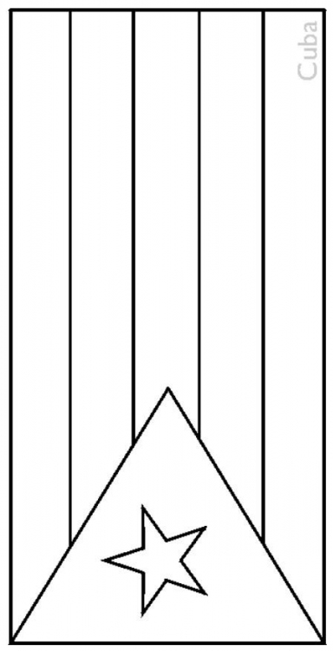
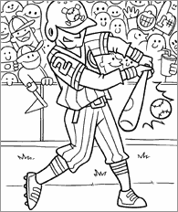
C
U
B
A

