Slide 1
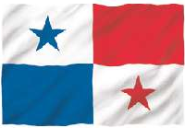
Panama
Notes:
The colors represent the 2 political parties Liberals (red) and conservatives (blue)

Slide 2
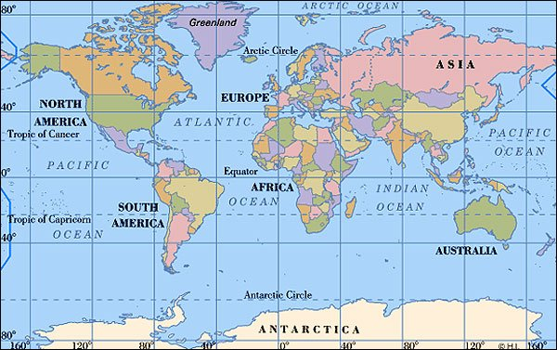
On which continent is Panama?
North America

Slide 3
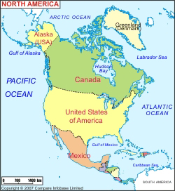
Where in
North America?

Slide 4
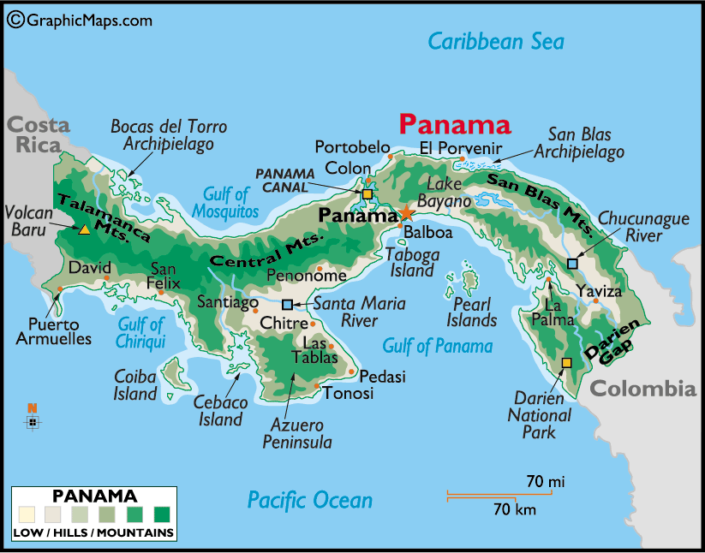
Population 3.3 million people
(around ½ of WA state)
Capital – Panama City
Language – Spanish
14% English
Size - 30,193 sq. mi
(less then ½ of WA)
Notes:
Money - Panama uses the US Dollar for bills but the coins are called Balboa. Yet, the official national currency of Panama is the Balboa.
Ruled by Spain 1513-1821
Aligned with Columbia until 1903
Exports: Bananas, Coffee, Petroleum products, fish, sugar

Slide 5
Panama Canal Completed 1914
Begun by France 1881
USA took over in 1903
From NYC to San Francisco
Around horn 14,000 miles
From NYC to San Francisco
Using the canal 6,000 miles
Canal Walls are 7 ft. thick
Takes a ship about 10 hours to cross
Panama Canal

Slide 6
50 miles wide
Sun rises in Pacific Ocean and sets in Atlantic Ocean
Notes:
The Panama Canal is about 50 miles long.
Normally the sun rises on the east coast, and sets on the west coast. This is the ONLY place on earth where the sun can rise on the west coast and set on the east coast.

Slide 7
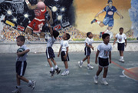
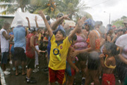
Life as a Kid
Notes:
After school, Panamanian kids participate in sports, the arts, or they just hang out with family and friends. In the interior, nearly all children help out with the household chores. Such chores may include cooking and cleaning or cultivating and harvesting the crops that the family has planted to eat or sell in the upcoming year. Families who have cows expect their children to help with the milking.
In Panama, people often say that you haven’t eaten if you haven’t had rice (arroz). Rice is served with nearly every meal. It is eaten with eggs, chicken, beef, sardines, meat, fish, potatoes, or beans. Corn and plantains (a starchy, banana-like fruit) are also a big part of the Panamanian diet. Fish is inexpensive and often made into a soup. People usually eat vegetables as part of the main dish or in a salad. The national dish of Panama is sancocho (a chicken stew). Other common dishes include guacho (rice soup), bollo (corn mush that has been boiled in corn husks), corn tortillas, and carne guisado (stewed meat with tomatoes and spices). Arroz con pollo (rice and chicken) is eaten on special occasions. Fruit is eaten often as a snack. Chicha, a popular drink, is made from fresh fruit, water, and sugar. A variety of international foods are eaten in cities, along with traditional foods.
Panamanian kids are required to go to school between the ages of seven and fifteen. All students attending public schools wear uniforms, usually blue and white. The school year begins in March and ends in December, leaving January and February for summer vacation. After completing primary school, most students go on to secondary education. Some of these secondary schools emphasize academics while others focus on vocational training (teaching students skills for industry or agriculture). Agriculture is a relatively small part of the economy in terms of income, but Panama has many farmers who support themselves and their families with what they harvest each year. They grow bananas, rice, coffee, sugarcane, and vegetables. They also raise livestock.

Slide 8
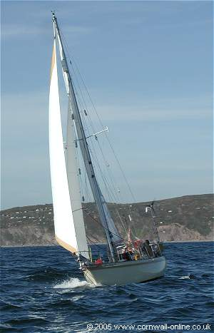
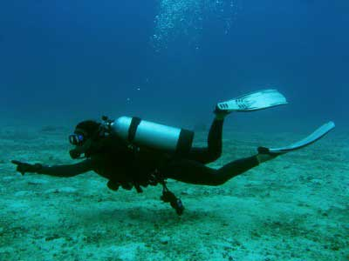
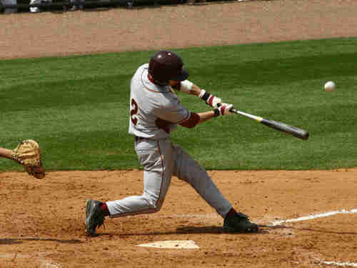
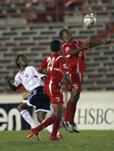
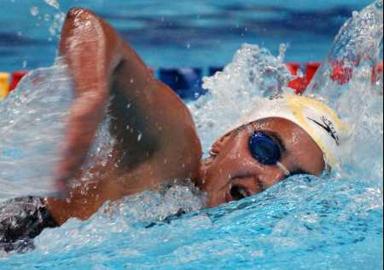
Sports
Notes:
Because the US was involved in much of the work on the Panama Canal, they follow a lot of the same types of sports as the US.

Slide 9
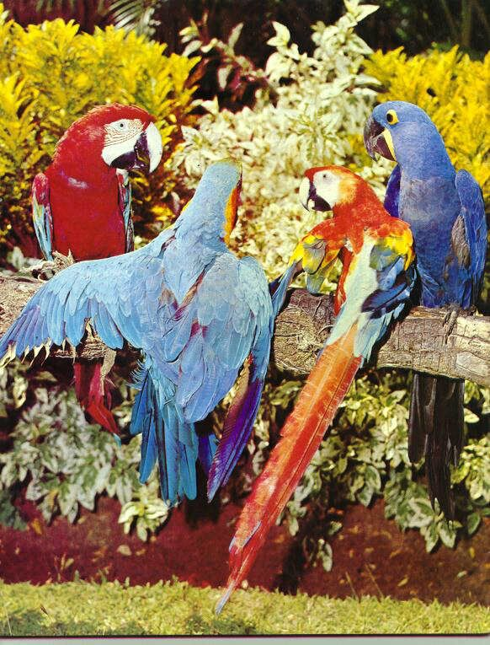
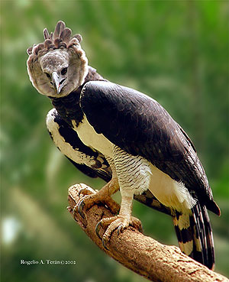
Animals
Harpy Eagle
Harpy Eagle
Macaw
Notes:
National bird of Panama
Size – 35-41 inches. Wingspan of 6 ½ ft. Weighs 10-20lbs
Eats animals that live in trees – sloths, monkeys. Opossums and some reptiles and birds.
Harpy Eagles are considered to be one of the world’s largest and most powerful eagles. Although this eagle has hind talons up to the size of grizzly bear claws, they typically can only fly with prey weighing up to approximately one half of their body weight.
MACAW
Habitat: forests, especially those that grow in swampy ground or along rivers; more open country when searching for food.
Food: nuts, fruit, seeds, berries. Macaws are members of the parrot family which has 340 species. There are 16 species of macaw at the moment but some of these are close to extinction. The largest species of macaw is the hyacinth which is 3 feet long from head to tail tip. The red-shouldered macaw is the smallest, measuring 10 inches.
Although the macaw has such brilliant colors, it is actually very difficult to spot up in the tree canopy, against the golden shafts of sunlight and blue sky. This camouflage gives it some protection against birds of prey.
Habitat destruction. Eight of the sixteen species of macaws are classified as endangered and all populations of macaws are declining. They are mostly restricted to the threatened rainforests of South America and these are being cut down at an alarming rate to make way for agriculture. This is a serious threat to the future survival of all macaws.

Slide 10
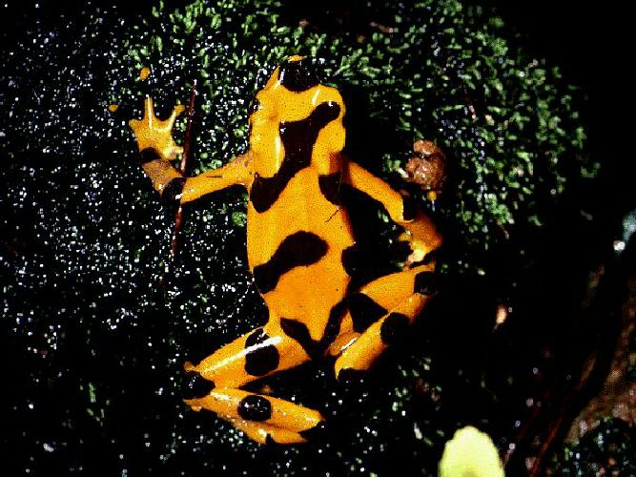
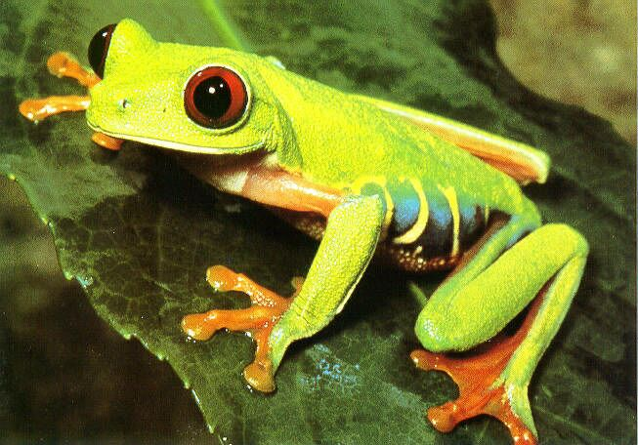
Golden Tree Frog
1.5 – 3 inches
Live in cloud and rain forests
Red Eyed Tree Frog
4 – 7 cm long
Bright colors and red eyes cause
Startle coloration, giving predators
Pause, leaving the frog to escape

Slide 11
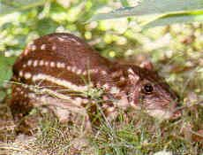
Conejo
Second largest rodent
13-27 lbs.
Nocturnal
Eats fruit, seeds, roots

Slide 12
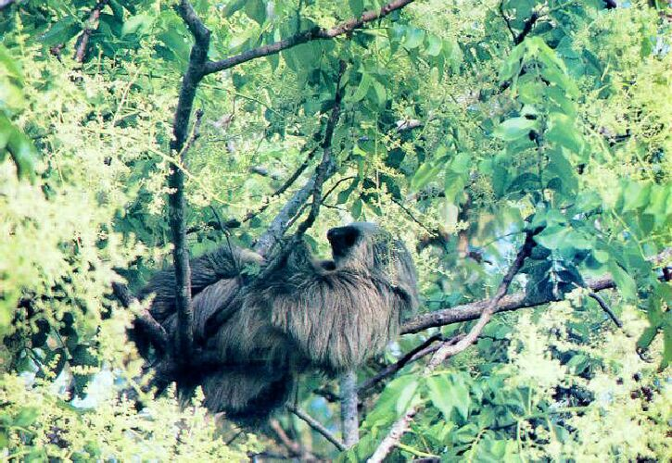
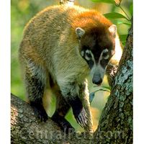
Sloth
VERY slow – 15 feet/minute
Fastest speed 1.2 mph
Live mostly in trees
Sleep 15-18 hours/day
Only go to the bathroom 1x/wk
Coatimundi – cousin to raccoon
Not Nocturnal
Omnivores
When surprised, the entiregroup will leap into the trees while emitting clicking and explosive "woofs" type of sounds.

Slide 13
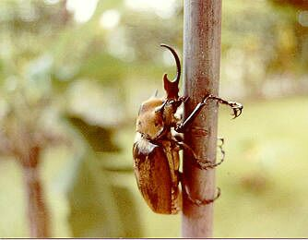
Play
Notes:
The rhinoceros beetles or rhino beetle are among the largest of beetles, and their common name refers to the characteristic horns borne by the males of most species in the group. The male beetles use their horns in mating battles against other males.
The larvae feed on rotten wood while the adults feed on nectar, plant sap and fruit. Rhinoceros beetle larvae are sometimes fried and eaten as a bush delicacy. Rhinoceros beetles are popular children's pets in Asia. They are clean, easy to maintain, and safe to handle.
In Asian countries, male beetles are also used for gambling fights since they naturally compete for female beetles with the winner knocking the other off a log.
Rhinoceros beetles are also the strongest animals on the planet in relation to their own size. They can lift up to 850 times their own weight.[1] To put this into perspective, if a human of average height and weight had the strength of the rhinoceros beetle, he would likely be able to lift a 65 ton object (Dad lifting 30 elephants).

Slide 15
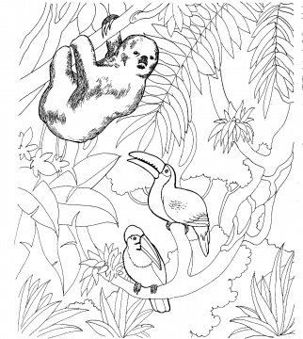
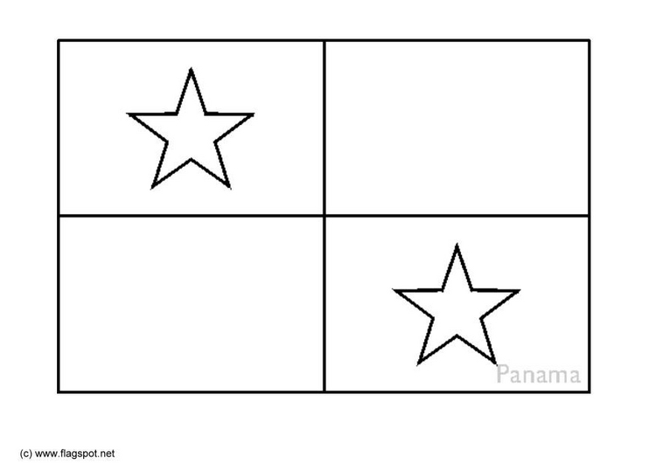
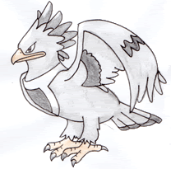
azul
rojo

