Slide 1
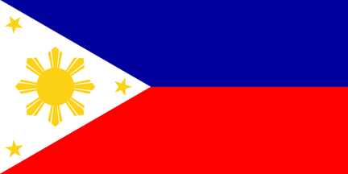
Philippines
Notes:
The country was named after King Philip II of Spain
The stars on the Philippines flag symbolize the three main islands: Mindanao, Luzon, and the Visayas. The sun’s eight rays represent the provinces that fought for independence from Spain. Blue stands for the country’s ideals, and red for courage.

Slide 2
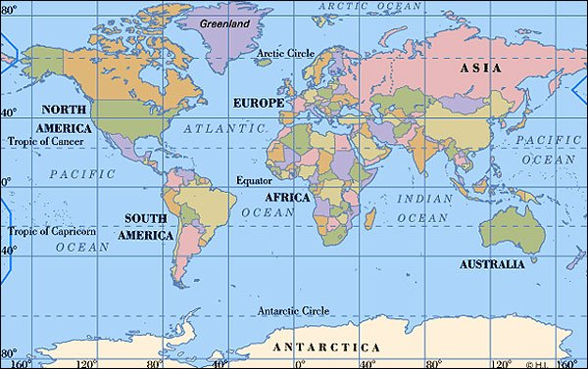
On which continent is the Philippines?
Asia

Slide 3
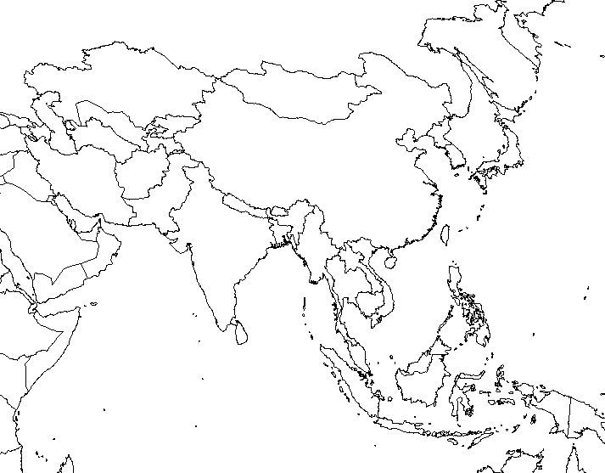

Slide 4
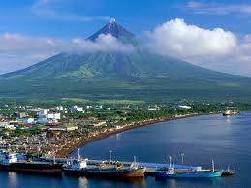
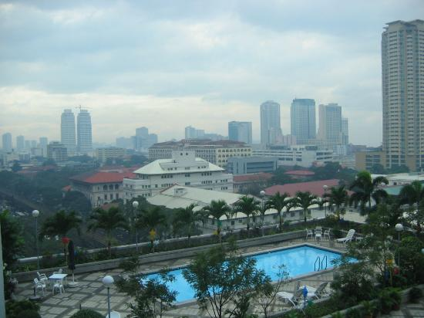
Capital – Manila Imports - electronic products,
mineral fuels
Size – 115831 sq mi Exports - electronic products,
coconut oil, fruit
Population – 101 million
Time Difference - +15hrs
Notes:
the capital city, Manila, was named for a white-flowered mangrove plant, the nilad
The Philippines consists of more than seven thousand islands. The islands are spread out over a very large area, but if you stuck them all together, they would be about the size of Ecuador or Arizona. Most people live on 11 main islands; the largest are Luzon and Mindanao. Located in between Taiwan and Borneo, the Philippines is about 500 miles (800 km) away from the Asian mainland. Mountains, some of which are active volcanoes, cover many islands. About one quarter of the land is covered by forests. Most of the islands have many streams and sandy beaches, and earthquakes are common. The weather is tropical, usually hot and humid with a rainy season from June to October. The Philippines is in a typhoon belt, meaning that a hurricane could happen at any time.

Slide 5
Can you say it?
Tagalog (Filipino) and English
Hello Kumusta (koh-moo-STAH)
Good-bye Paalam (pah-AH-lahm)
Please Pakisuyo (pah-kee-SOO-yoh)
Thank you Salamat (sah-LAH-maht)
Yes Oo (OH-OH)
No Hindi (hin-DAY)
Notes:
Close to 70 languages are spoken in the Philippines, but almost everyone can understand Tagalog (Filipino) and English, the two official languages. Because the United States ruled the country for 48 years, English is used still in the schools, businesses, and government. Filipinos might have math and science classes in English but history or reading classes in Tagalog. In Luzon, spoken English is heavily laced with Tagalog words in casual conversation. Just remember, in the Philippines it’s rude to speak in a language that someone listening can’t understand!

Slide 6
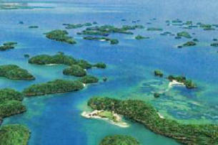
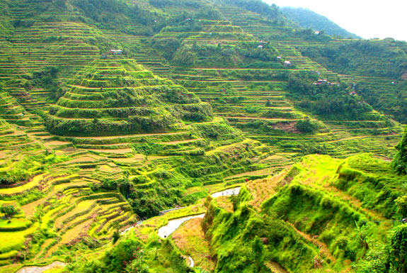
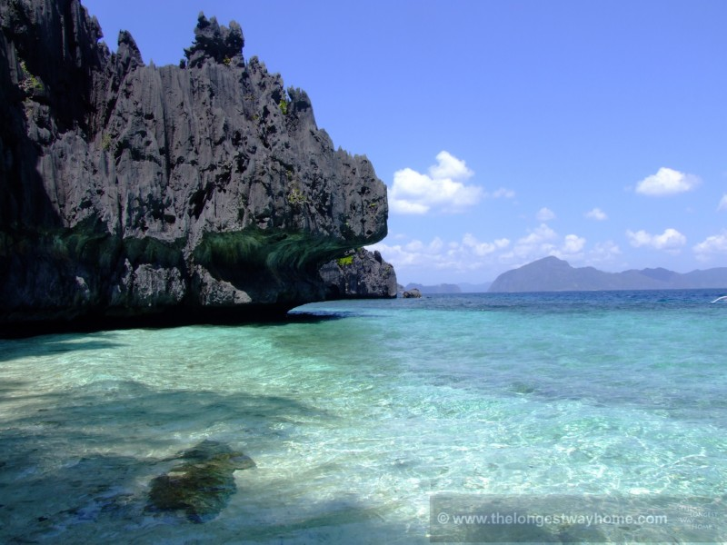
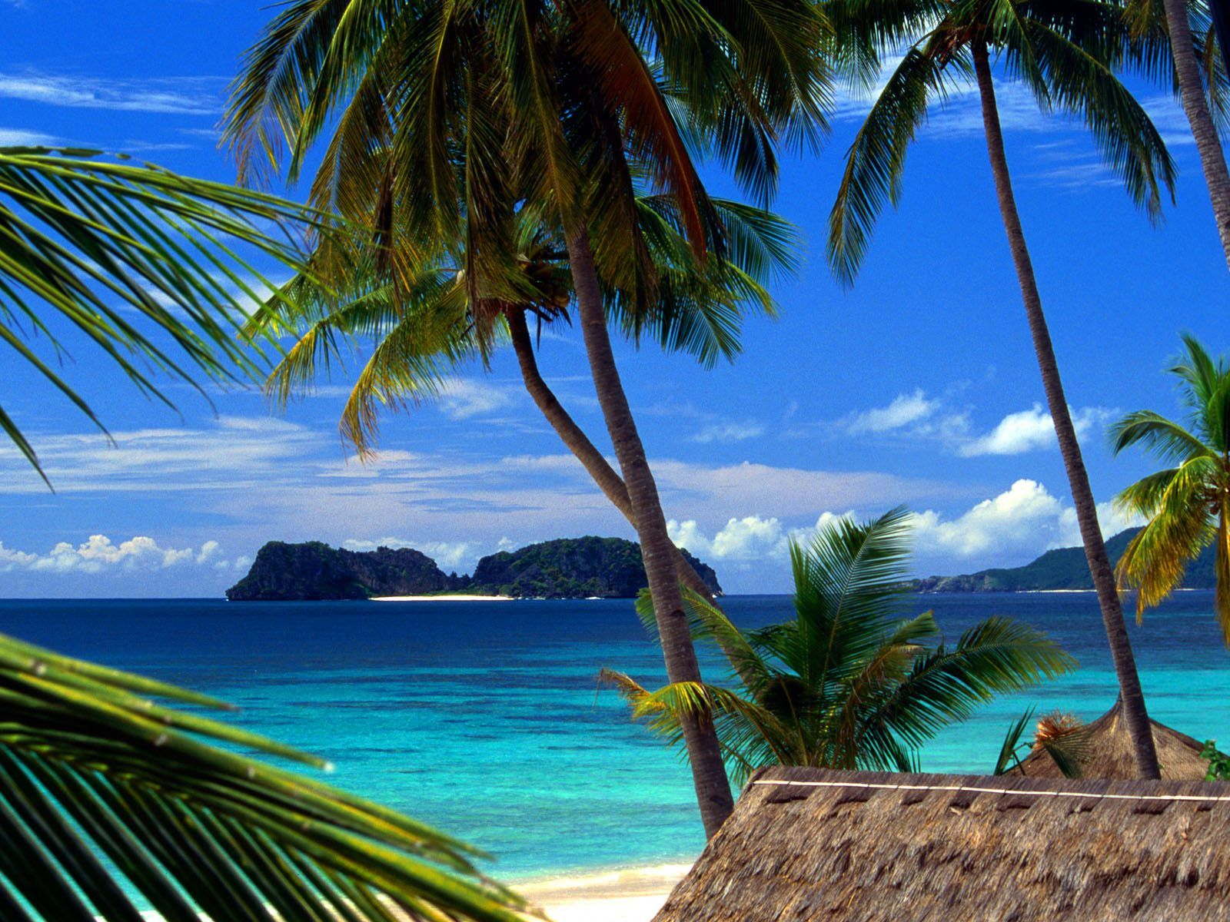
Notes:
1521 Ferdinand Magellan claims the islands for Spain and is killed by Lapu Lapu
1565 The Philippines becomes part of the Spanish Empire as Spain establishes its first permanent settlement in Cebu
1896 Writer José Rizal, who helped start the independence movement, is executed
1899–1901 The Philippine-American War begins after Spain turns the Philippines over to the United States
1941 Japanese invade and occupy the islands during World War II
1946 Americans and Filipinos regain control of the islands; the Philippines gains independence and is renamed the Republic of the Philippines
1947 The United States is awarded military bases on the islands
1951 The Philippines signs a peace treaty with Japan
1960s Rioting and revolutionary movements occur over land and religious issues
1965 Ferdinand Marcos becomes president
1972 President Ferdinand Marcos declares martial law (a government-declared emergency in which military forces administer the law) 1973 A new constitution gives Marcos absolute powers 1981 Martial law is lifted, and Marcos wins the presidential election 1986 The People’s Power Revolution drives out Marcos, and Corazon Aquino takes control

Slide 7
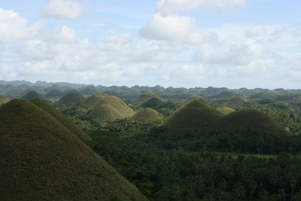
Notes:
The Chocolate Hills are an unusual geological formation found in Bohol, in the Central Visayas region of the Philippines. It is found that there are 1,776 hills spread on an approximate 50 square kilometer area. Depending on the season, the Chocolate Hills change in color, varying from green to chocolate brown.
The Chocolate hills are the most famous tourist attraction in Bohol. The Chocolate hills were featured in the Philippine Tourism Authority’s list of Philippine tourist destinations and are the Philippines’ third National Geological Monument. Proposals to include the Chocolate hills in the UNESCO World Heritage Site list are currently being conducted.
The Chocolate Hills look like women’s dress, or giant mole hills, or something out of a child’s drawing. The unusual thing about it is that it is a natural phenomena! Geologists believe that the hills were formed from marine limestone on top of a clay layer. The Chocolate hills are uniform in shape, some standing from 30 to 50 meters high. They are usually covered with grass the year around, but turn brown during the dry season, thus the name. You can see the magnificent view by climbing 214 steps to an observation outpost above the hills.

Slide 8
Life in the Philippines
Notes:
Filipino life is very different depending on where you live. If you lived in a small barrio (village), you might fetch water in buckets, clean the house, ride the carabao (water buffalo) home, or run errands. Some young children even help their families by selling small items. But in a wealthier home, you would do pretty much the same things you do in the United States. Usually, kids wear shorts (or skirts for girls) and T-shirts, but they get dressed up for special occasions.
Nearly all Filipino children begin school at age six or seven. After six years of elementary school, most of the students continue on to four years of high school. High school includes one year of military training. Graduation is at age 16 or 17. Classes tend to be very large. There might be 40 to 60 kids in one class. In some rural areas, especially in the mountains, children have to walk several miles just to get to class, and they even have to bring their own stools to sit on since schools don’t have enough money. But education is still very important to Filipinos.
Family is most important. It is practically unheard of to move out of the house at the age of 18. When children get married they typically still live with their parents (and the parents just add on to make the house bigger).

Slide 9
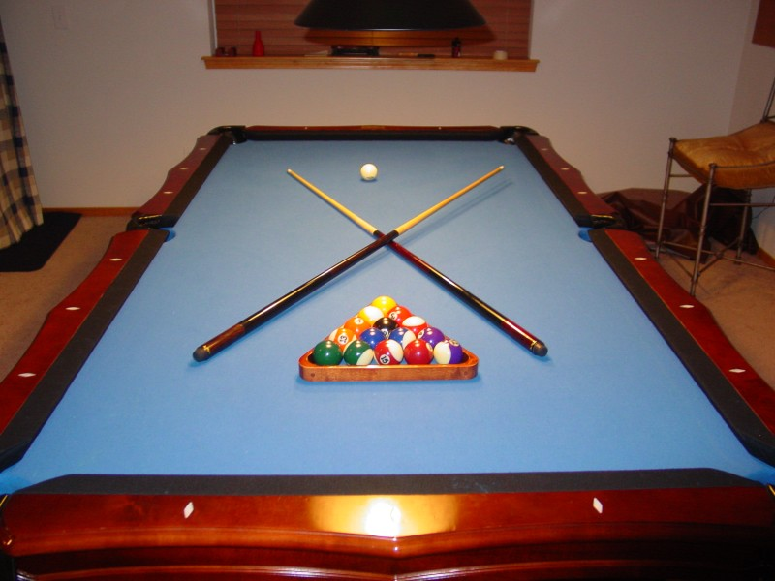
Sports
Notes:
Because toys are expensive, most kids play with anything they can find. Kids like to play marbles, rubber bands, war games (often with paper guns), house, and takyan (a game using a soft-drink cap and a candy wrapper). Younger kids go outside or to their cousins’ or neighbors’ homes to play. Teenagers get together after school and go to a mall or a park. Families enjoy picnics at the beach. Sports generally are played on Sunday. Boys enjoy basketball, and courts can be found all over the cities. Girls play sports mostly in school, where volleyball and track are popular.

Slide 10
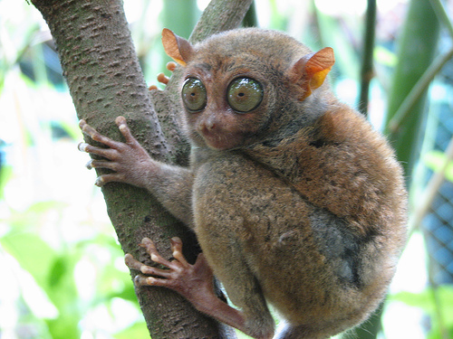
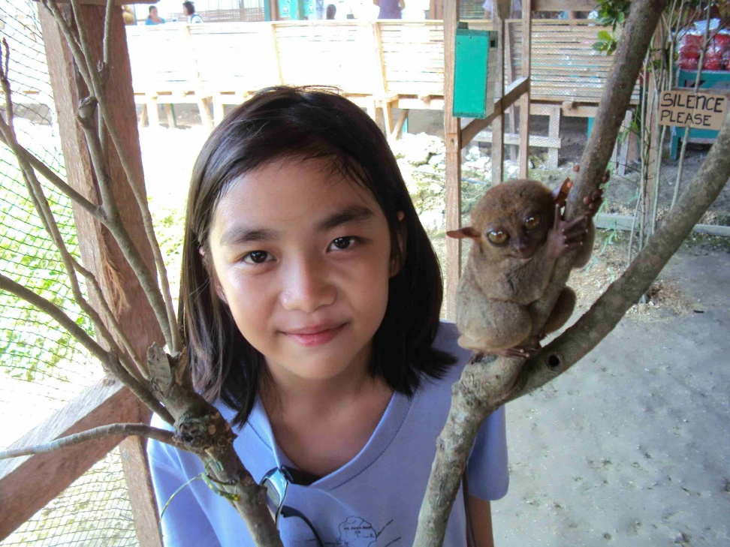
Animals
Tarsiers
Notes:
The tarsiers, unlike any other primates, completely refuse to eat any plant matter whatsoever. They eat mostly insects but sometimes enjoy birds, crabs, snakes, bats, etc, as long as it is something they can grab and eat its little head, like crickets and grasshoppers for example. They may be eaten themselves by snakes, lizards, owls, and other birds of prey. The hunt may go like this - The hunter waits on its haunches staring with its large eyes. A grasshopper passes by and slowly the tarsier leans in until Wham! it suddenly seizes the insect with both hands and gobbles it up screwing up its tiny face contentedly.
Being nocturnal helps them avoid some predators in the dark night. Alas, there are snakes, birds of prey and other animals that are also stalking in the dark.
If a tarsier is attacked by a predator, all of the tarsiers nearby may swarm and attack the predator.
The tarsier is an amazing jumper able to jump more than 40 times it's own body length. The hind legs can be twice the head and body length. In fact, their name comes from their powerful ankle bones - the tarsals. They like to jump and cling to trees.

Slide 11
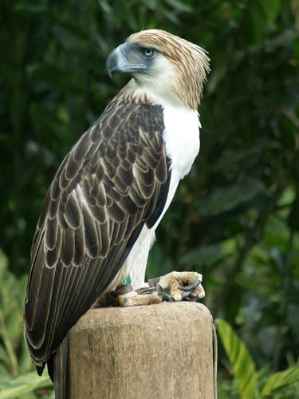
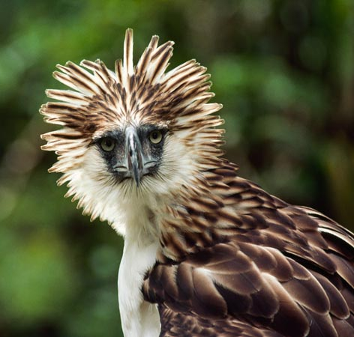
Philippine Eagle
Notes:
The country’s national bird is the rare Philippine eagle (sometimes called the monkey-eating eagle); there are only about two hundred of these birds still living in the wild.
The Philippine Eagle (Pithecophaga jefferyi), also known as the Monkey-eating Eagle, is an eagle of the family Accipitridae that is endemic to forests in the Philippines. It has brown and white-coloured plumage, and a shaggy crest, and generally measures 86 to 102 centimetres (2.82 to 3.35 ft) in length and weighs 4.7 to 8 kilograms (10 to 18 lb). Among the rarest, largest, and most powerful birds in the world, it has been declared the Philippine national bird.^{[2]} It is critically endangered, mainly due to massive loss of habitat due to deforestation in most of its range. Killing a Philippine Eagle is punishable under Philippine law by twelve years in jail and heavy fines.^{[3]}

Slide 12
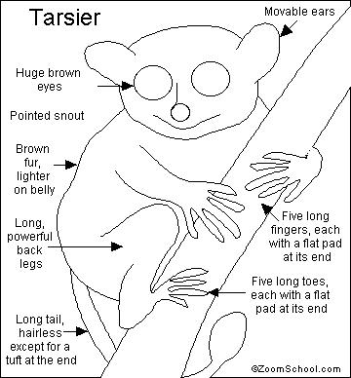
The Philippines
Hello Kumusta (koh-moo-STAH)
Good-bye Paalam (pah-AH-lahm)
Please Pakisuyo (pah-kee-SOO-yoh)
Thank you Salamat (sah-LAH-maht)
Yes Oo (OH-OH)
No Hindi (hin-DAY)

