Slide 1
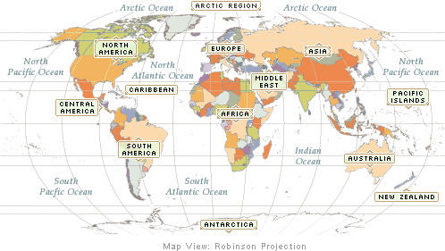
We are here➔
⬅ Romania

Slide 2
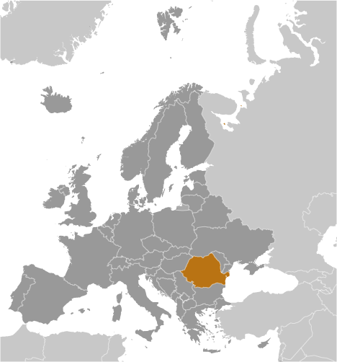

Slide 3
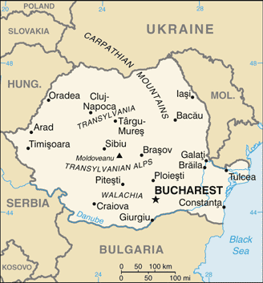

Slide 4
Notes:
Romanian Flag

Slide 5
Notes:
Coat of Arms

Slide 6
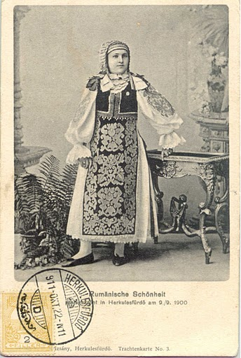
Notes:
Banat Romanian costume

Slide 7
Romanian Phrases
Good morning. Bună dimineaţa. Boo-nuh di-mi-na-tsa
Hello/Good day. Bună ziua. Boo-nuh zee-wa.
Good evening. Bună seara. Boo-nuh sea-ra.
Good-bye. La revedere. La rev-eh-de-ray

Slide 8
Days of the Week in Romanian
Can you guess them?
luni loon’
marţi marts’
miercuri myer-koor’
joi zho’
vineri vi-ner’
sâmbătă sîm-buh-tuh
duminică doo-mi-ni-kuh

Slide 9
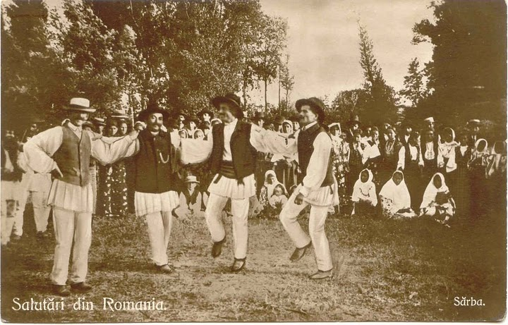

Slide 10
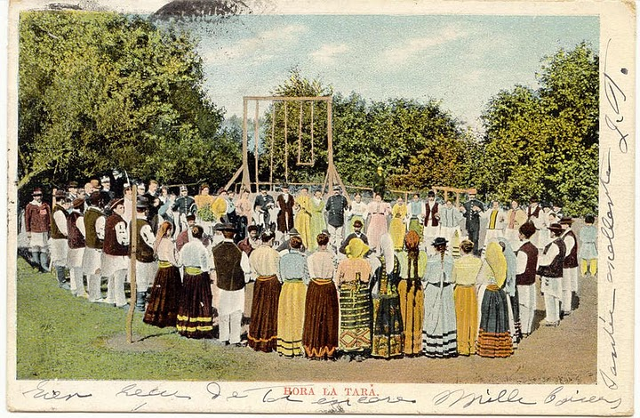

Slide 11
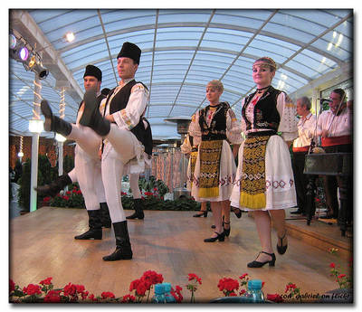

Slide 12
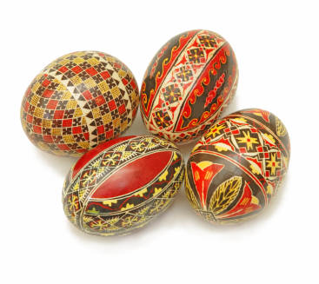
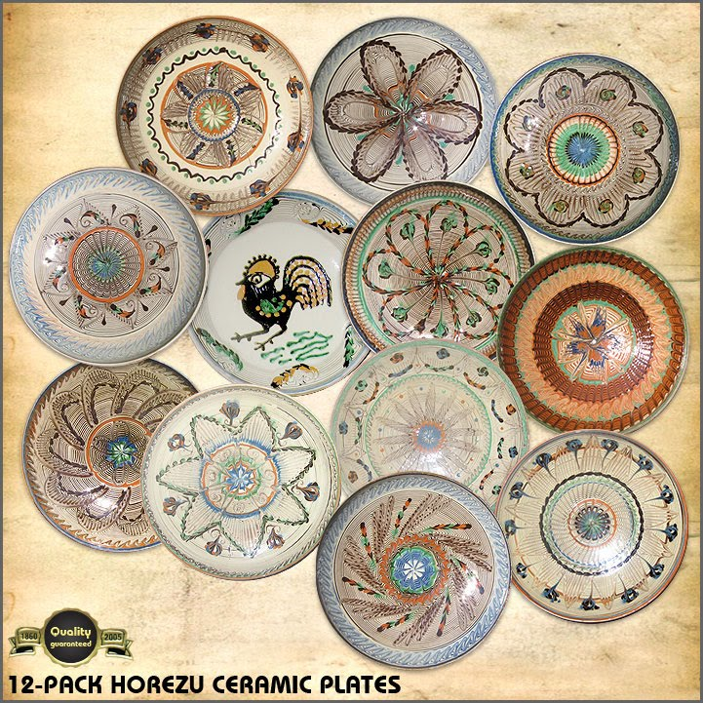
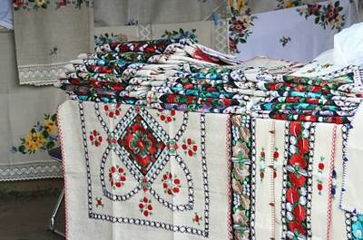

Slide 13
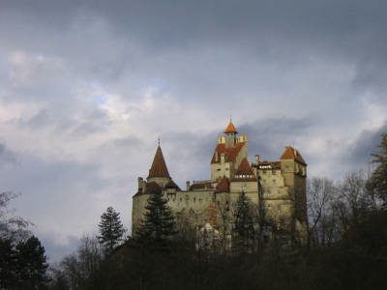

Slide 14
