Slide 1
TURKEY(English) TURQUIA (Espanol) Türkiye (Turkish)
Sra Melissa Cable

Slide 2
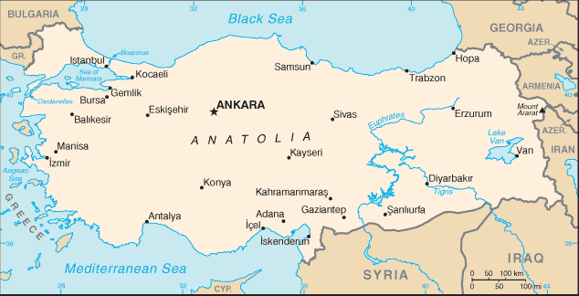
Over half of Turkey is surrounded by water.
Notes:
Turkey is bordered by the Black Sea, the Mediterranean Sea and the sea of Marmara

Slide 3
Turkey is on 2 continents: Europe and Asia
Notes:
Tur

Slide 4
Turkey is bordered by eight countries.
Notes:
Turkey is bordered by the Black Sea, the Mediterranean Sea and the sea of Marmara

Slide 5
The capital of Turkey is Ankara.

Slide 6
The largest city is Istanbul.
Notes:
3rd largest city in europe

Slide 7
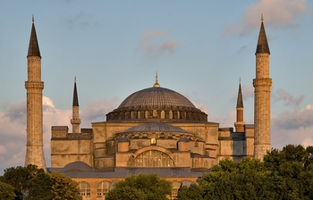
Istanbul
Sultan Ahmed Mosque
“Blue Mosque”
Hagia Sophia
Has served as a church, a mosque and now a museum

Slide 8
There are many ancient Greek & Roman ruins.
Notes:
3rd largest city in europe

Slide 9
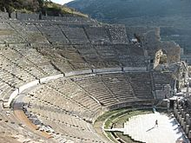
Ephesus
Library of Celsus
Theater

Slide 10
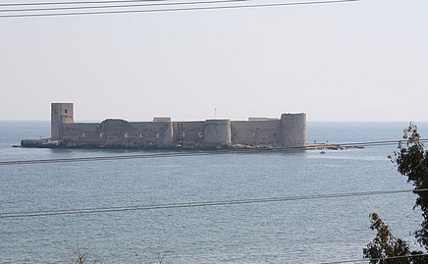
Kizkalesi
Maiden’s Castle
Theater

Slide 11
There are amazing natural wonders.

Slide 12
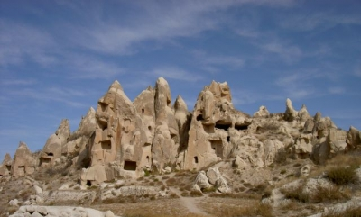
Cappadocia
“Fairy Chimneys” formed through volcanic activity

Slide 13
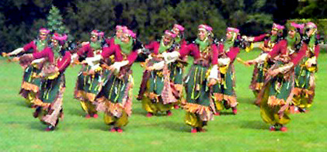
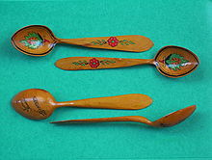
Turkish Folk Dancing
Kasik Oyunlari – “Wooden Spoon Dance”

Slide 14
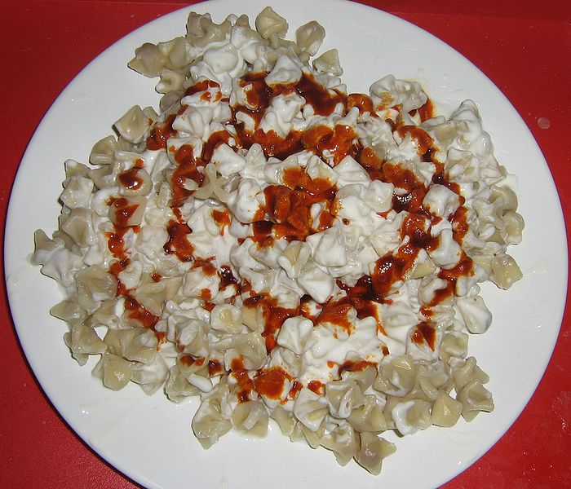
Turkish Food
Lamb, chicken, rice, kebab, eggplant
Meat-filled pasta dishes like manti

