Slide 1
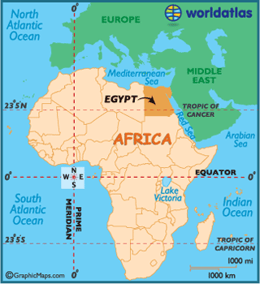
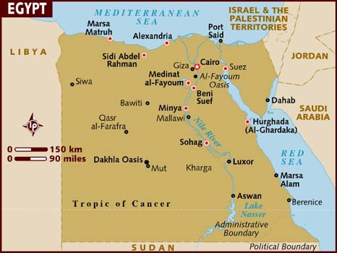
EGYPT

Slide 2
Basic Facts
Size: 386,000 square miles (about the size of Texas and New Mexico put together)
Capital City: Cairo
Other big cities: Alexandria, Giza, Shubra el Khema
Population: 82,079,636 (compared with U.S. population of about 311,800,000)
* Nearly all of Egypt’s people live in Cairo, Alexandria, and the surrounding areas of the Nile River and Suez Canal

Slide 3
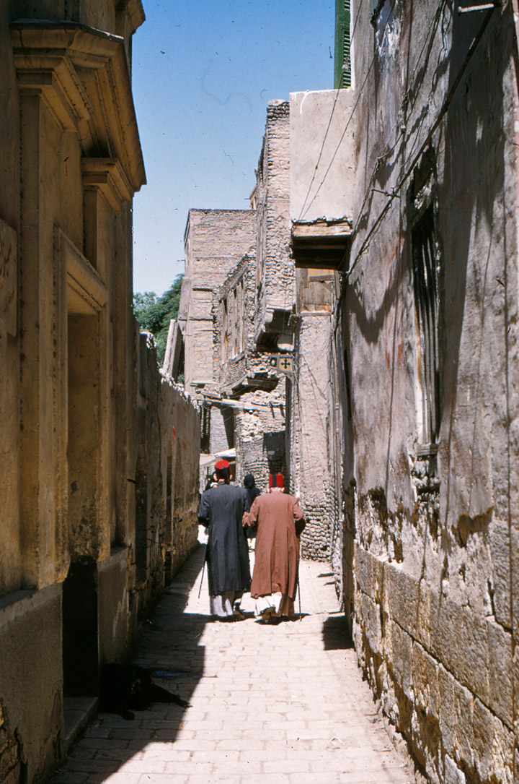
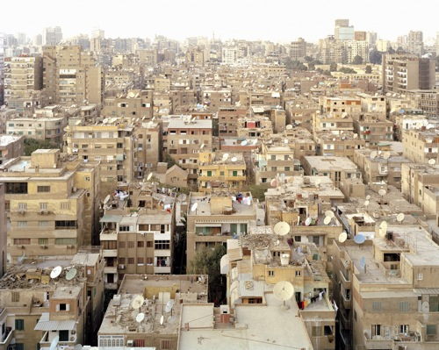
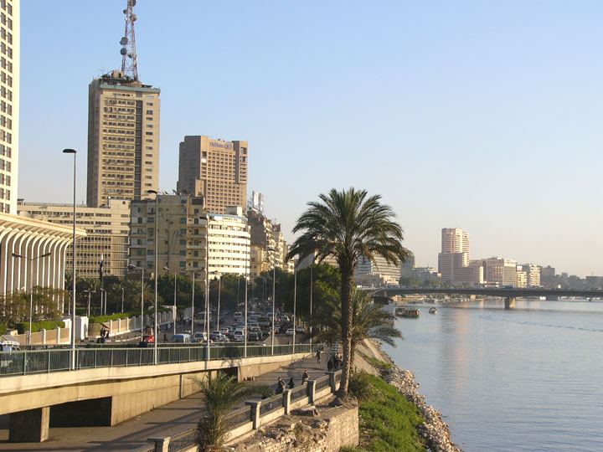
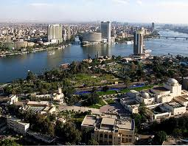
CAIRO

Slide 4
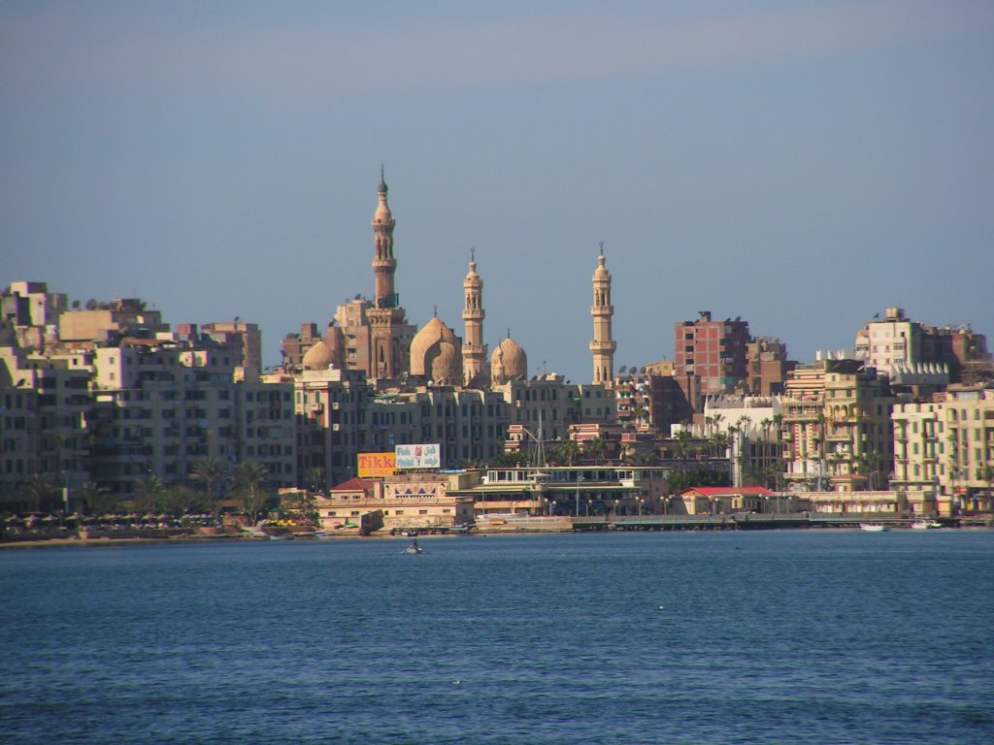
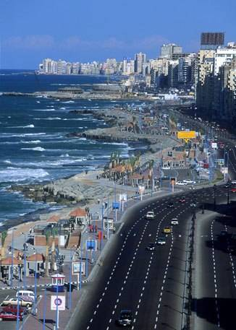
ALEXANDRIA

Slide 5
Climate
Egypt has two main seasons: a hot, dry summer (from May to Oct.), and a mild winter (from Nov. to Apr.)
Average temperatures in the summer are in the upper 90’s to over 100 degrees Fahrenheit
Winter temperatures are usually in the 60’s
Egypt gets little rain during the year. In many of the desert areas, it might only rain once in several years!
The capital city of Cairo averages about 2.5 cm of rain per year, compared with the 95 cm of rain Seattle receives per year!

Slide 6
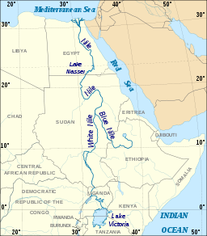
Geography
Egypt has the world’s longest river, the Nile. It is 4,130 miles long and runs through 10 countries in Africa (from Egypt down to Burundi and Tanzania).
The Nile is a very important river because it is a main source of water, food, and transportation for the Egyptians. It keeps the nearby land fertile for growing crops.

Slide 7
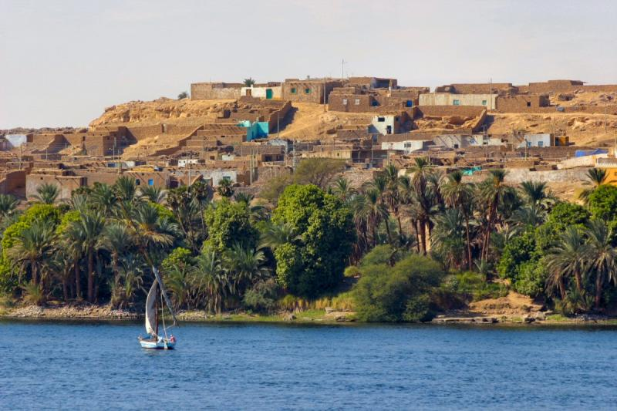
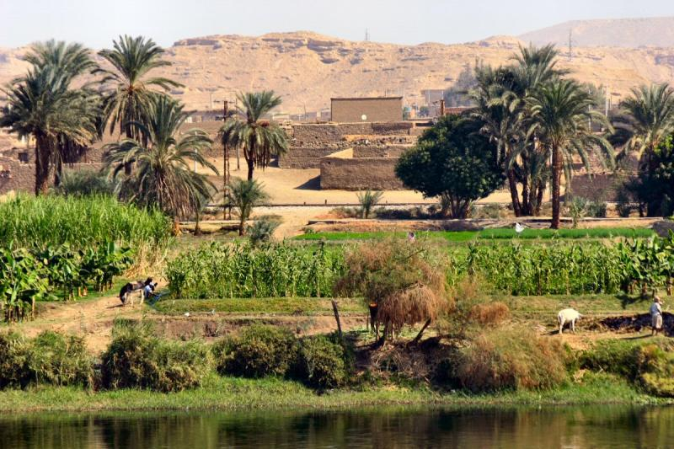
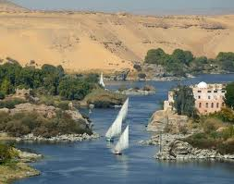
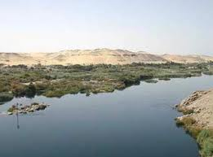

Slide 8
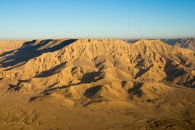
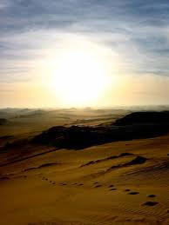
Where the Nile’s water stops flowing into the land, the desert begins. About 97% of Egypt is made up of desert. The desert is too dry and hot for people to live in and to grow crops on. This is why almost all of the country’s people live near the Nile.

Slide 9
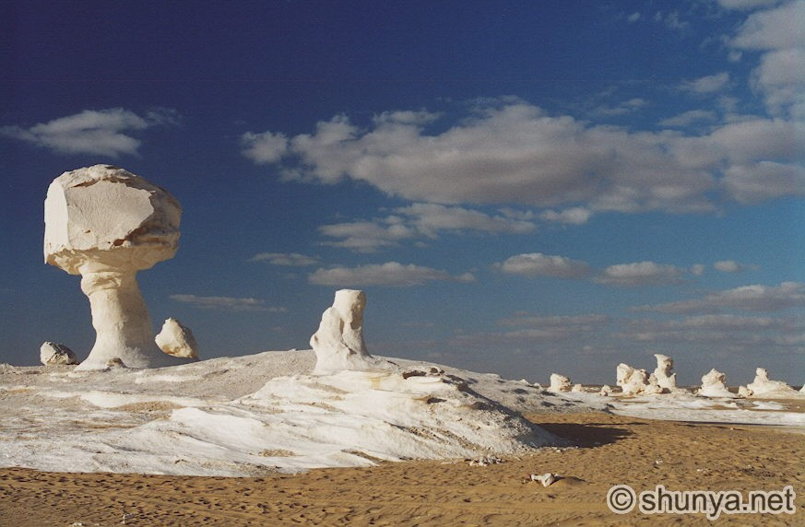
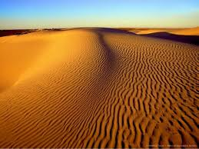

Slide 10
Ancient Egypt
Egypt was one of the greatest civilizations of a long, long ago. A civilization is a large people group that has reached high levels of achievement in many areas, like science, art, language, and government.
Egypt’s history goes back more than 7,000 years!
Ancient Egypt was ruled by pharoahs, who were like kings. The pharoahs had power over everything and were treated like gods.
Some of Egypt’s most famous landmarks are the pyramids built to house the pharoahs after they died.

Slide 11
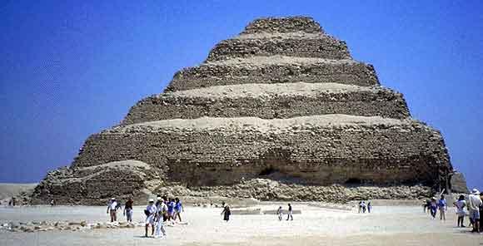
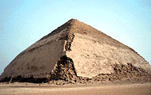
The earliest pyramid was the Step Pyramid.
Next came the Bent Pyramid.

Slide 12
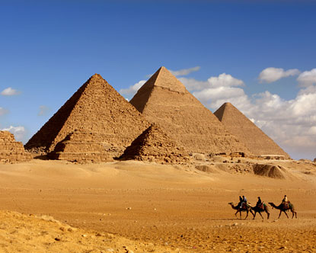
Eventually, the Egyptians filled in the sides of the pyramids and made them smooth.
The Pyramids of Giza

Slide 13
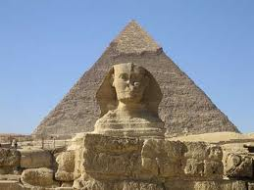
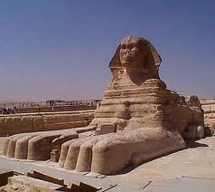
The Sphinx
This famous sculpture was built around the same time as the pyramids. It is a half-human/half-lion sculpture that was built to guard one of the pyramids.

Slide 14
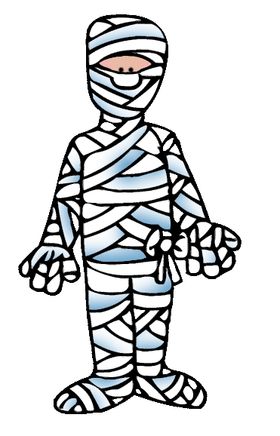
Mummies
Ancient Egyptians believed in life after death. When their loved ones died, they preserved the bodies by a process called mummification so that the person could be ready to move on to the after life.
Mummification was a process that took about 70 days to complete!

Slide 15
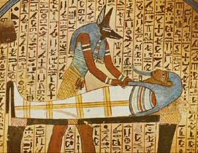
Making mummies involved many steps, including:
Cleaning the body thoroughly
Removing the organs, except for the heart, which was believed to be the center of thinking and feelings
Stuffing the body
Drying the body with a salt substance called Natron
Using special oils and herbs to help preserve the body
Wrapping the body with linen strips and a cloth sheet called a shroud
Putting the body into a coffin,
usually a stone coffin called
a “sarcophagus.”

Slide 16
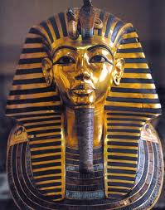
If you were a pharoah or were rich, you probably had decorative masks and coffins made for you from precious materials like gold and silver.
You were then buried in a tomb, often with items that were important to you, like jewels, household goods, and furniture.
The pyramids served as the tombs of Egyptian pharoahs, to protect their bodies from robbers.
King Tutankhamun’s mask

Slide 17
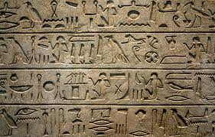
Hieroglyphics
Ancient Egyptian writing was made up of more than 2,000 picture symbols called hieroglyphics. Hieroglyphs depicted common Egyptian objects. A hieroglyph could represent the whole object, the sound of the object, an idea related to the object, or a syllable or group of sounds.

Slide 18
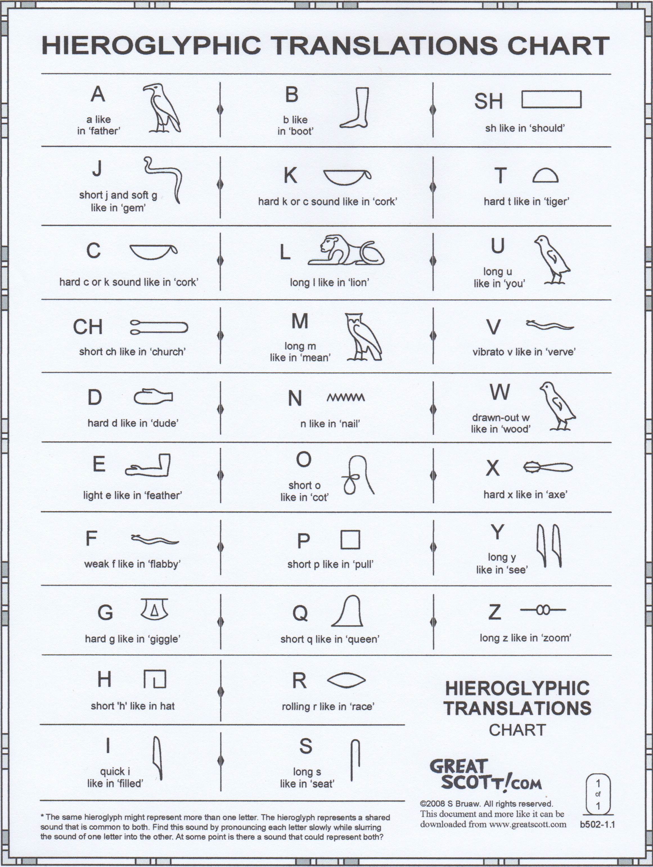

Slide 19
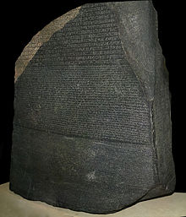
The Rosetta Stone
Hieroglyphics were a mystery until the Rosetta Stone was discovered near the mouth of the Nile in 1799.
This stone had three languages carved into it: Hieroglyphics, Egyptian Demontic, and Greek.
With these different languages found together, people were able to figure out how to translate hieroglyphic characters.

Slide 20
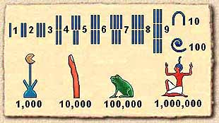
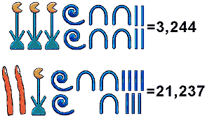
The Ancient Egyptians were also very good at math. They developed a number system using hieroglyphics.
They used fractions and did multiplication, division, and more difficult math like algebra and geometry. The pyramids themselves are proof of their high level of skill in mathematics!

Slide 21
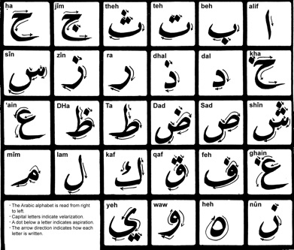
Modern Egyptian Language
Today, Egypt’s official spoken and written language is Arabic. English is also used, especially for government and business purposes.
Arabic is a language widely used in the Middle East region, but has variations in different countries.

Slide 22
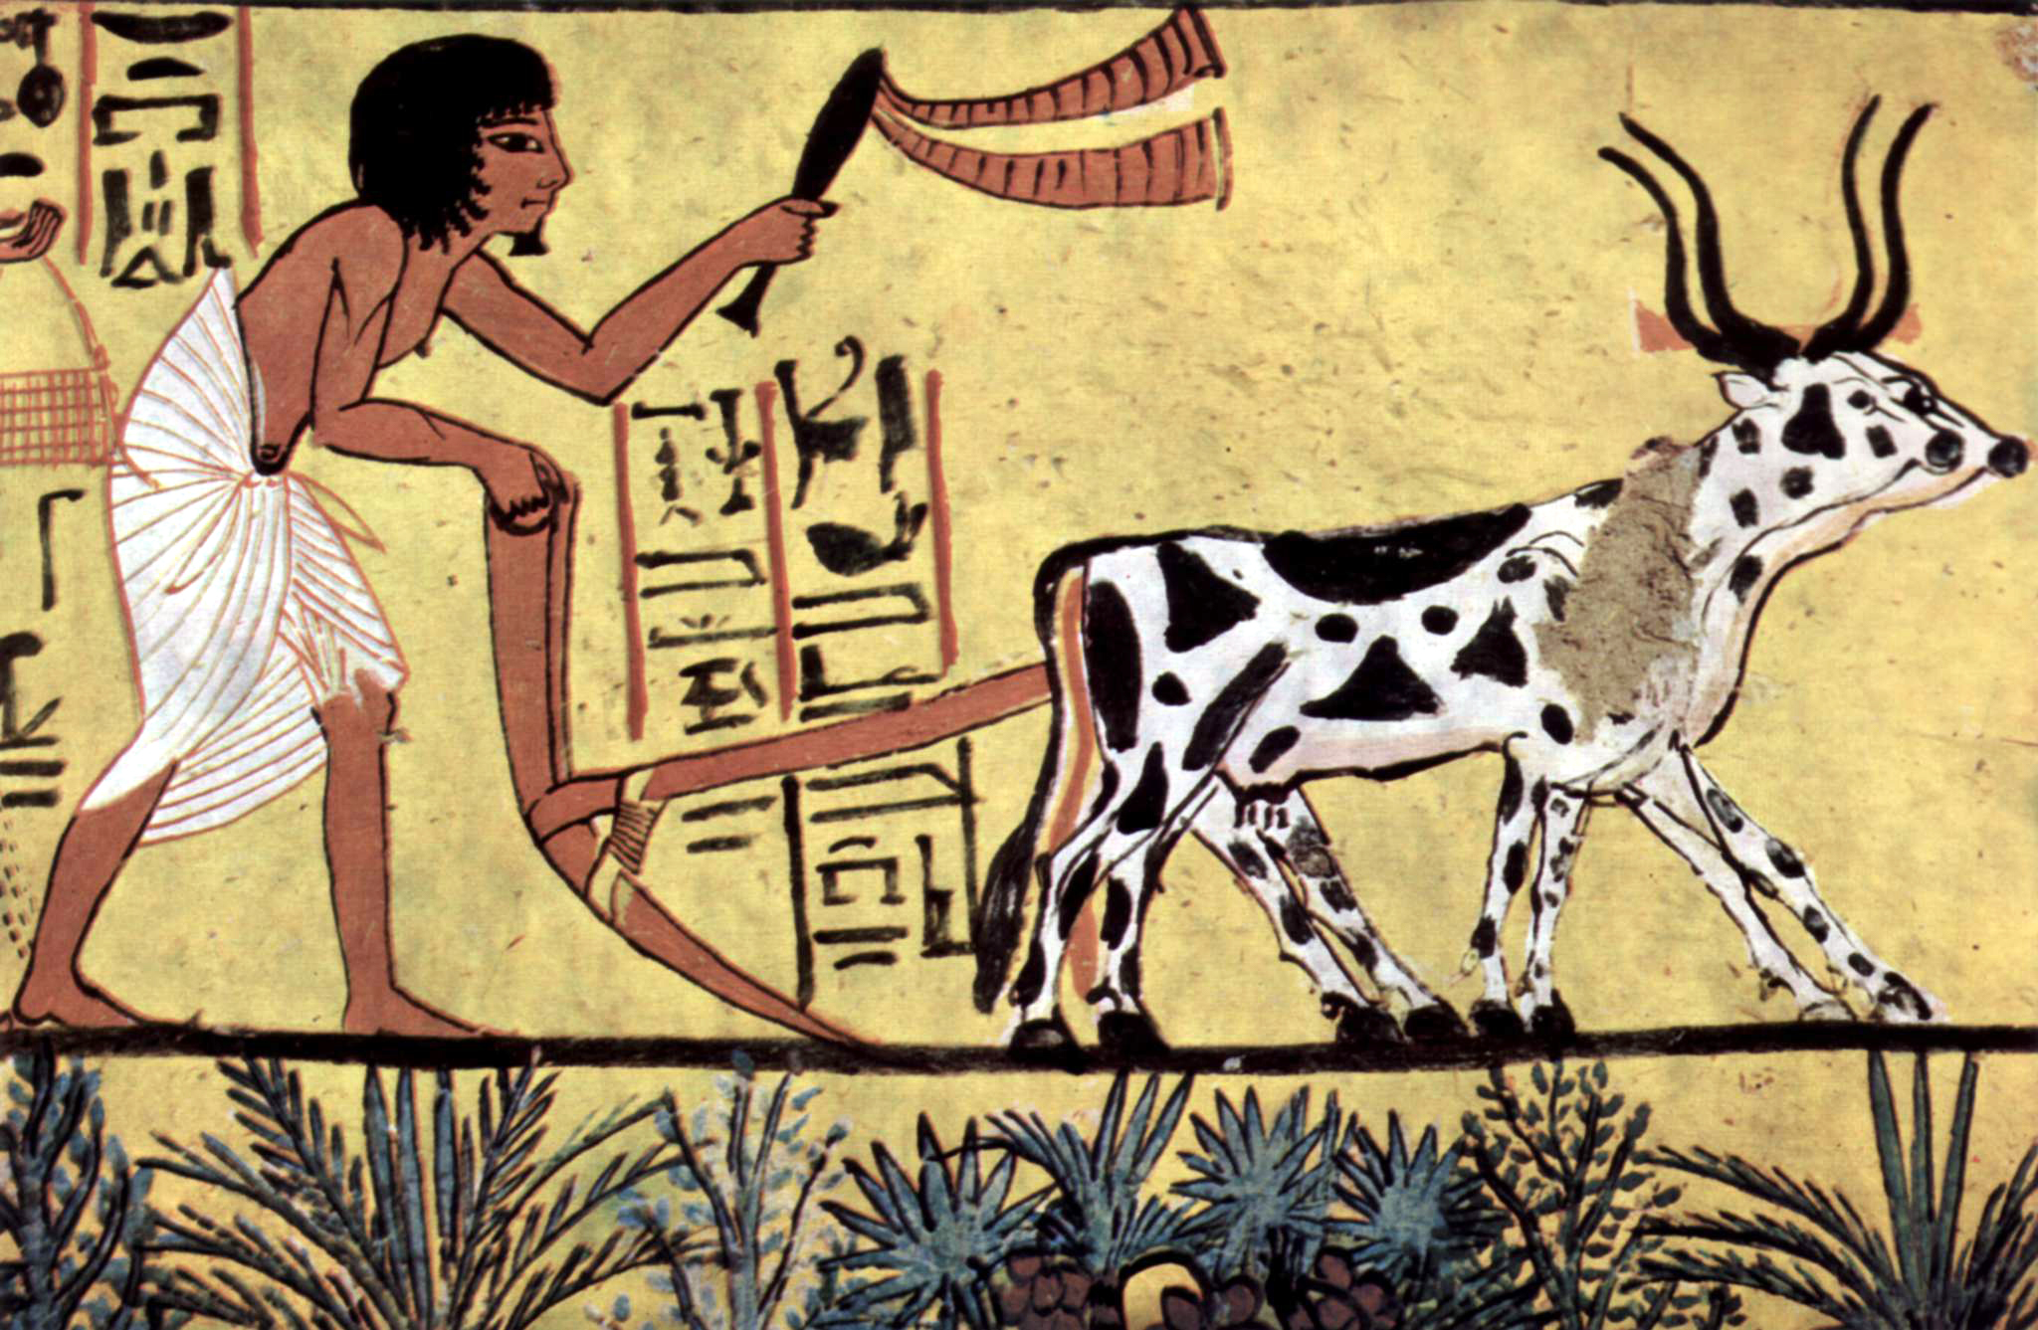
Egyptian Inventions
Besides building pyramids and creating hieroglyphic writing, the Egyptians also made other important inventions:
The Ox-drawn Plow – an invention used for loosening soil and preparing the ground to grow crops

Slide 23
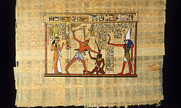
Papyrus – a flat sheet of material made from a reed-like plant which grew along the banks of the Nile River
The Egyptians used papyrus not only as paper for writing, but also for things like mats, baskets, rope, sandals, and sails for their boats

Slide 24
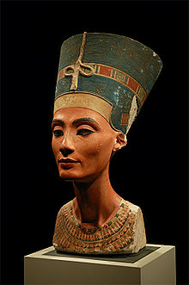
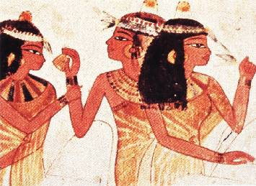
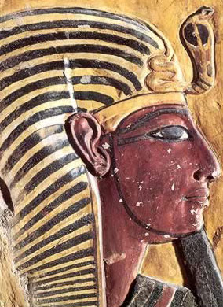
Cosmetics – seen on both males and females in ancient Egyptian pictures, carvings, and statues. Make-up was used for decorative as well as medical purposes, such as to ward off infection.

Slide 25
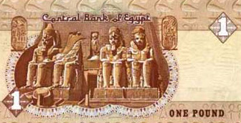
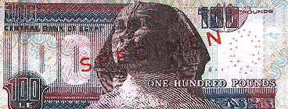
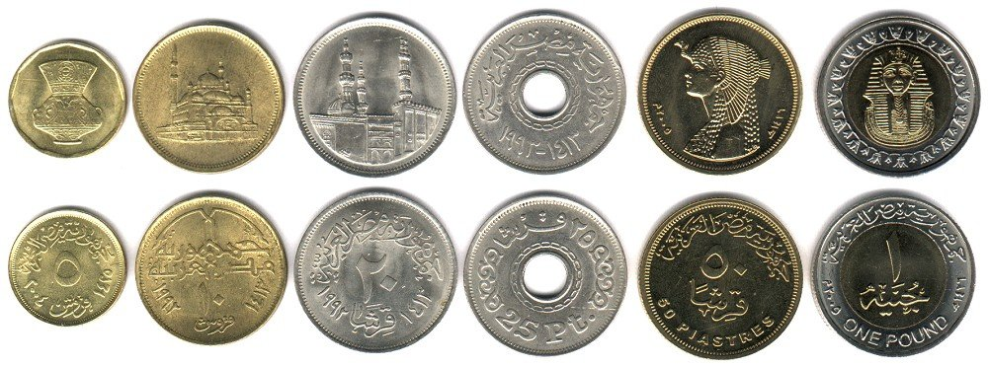
Egyptian Money
1 Egyptian Pound (EGP) = 17 US cents
6.04 EGP = 1 US Dollar
Coins: Piastres, Pounds
10, 20, 50 Piastre coins
100 Piastre = 1 Egyptian Pound

Slide 26
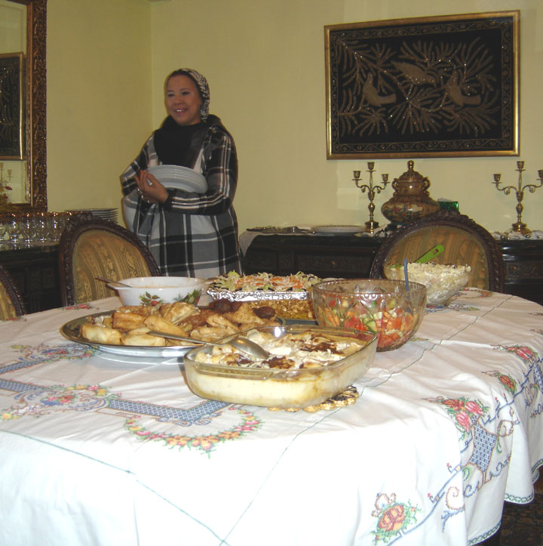
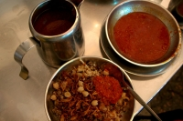
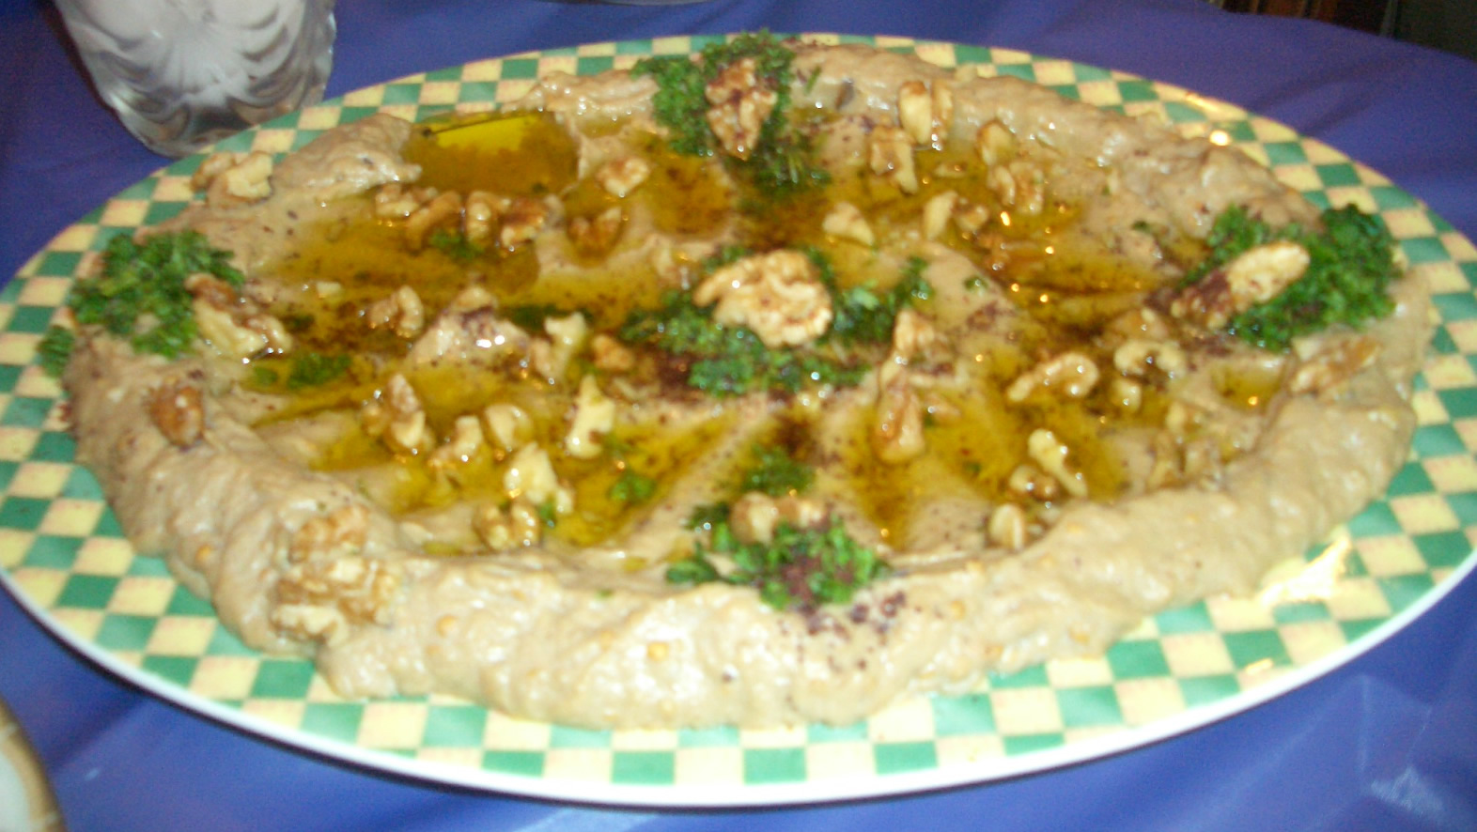
Egyptian Food
Typical Egyptian dish with lentils, rice, and tomatoes
A buffet given at home
Baba ghanoush: Pita dip made of mashed eggplant mixed with spices, olive oil and garlic

Slide 27
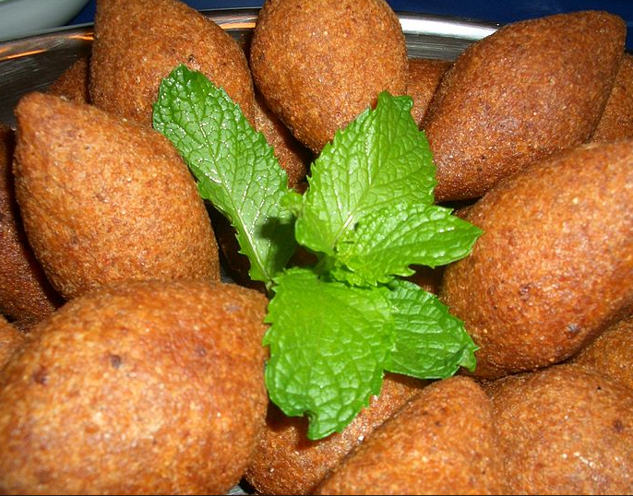
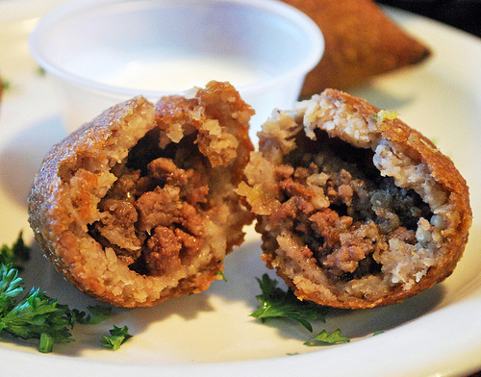
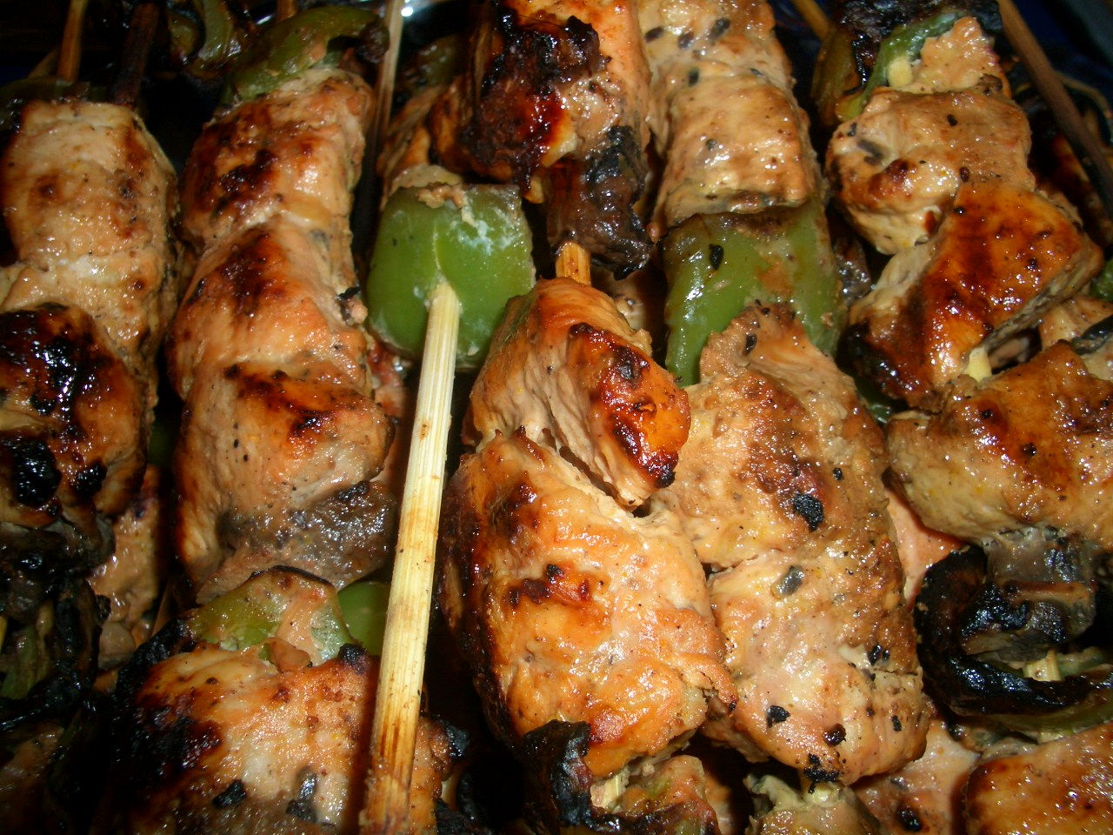
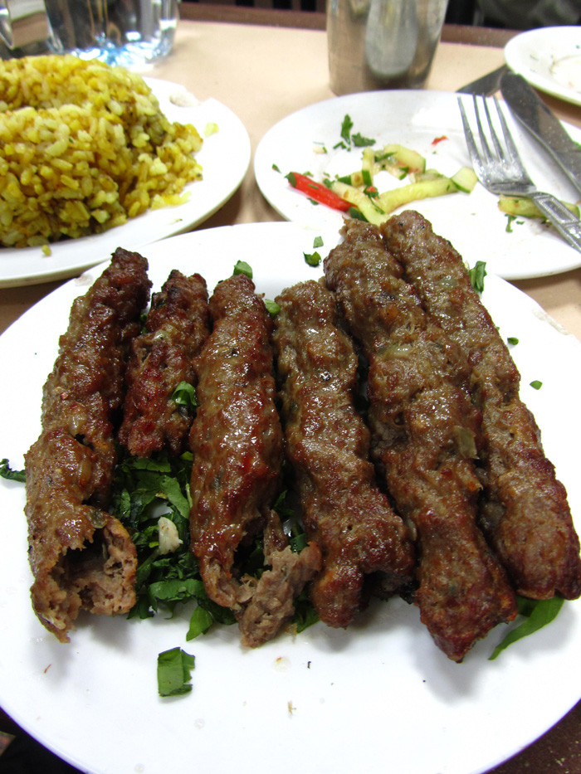
Egyptian Kibbah – a meat-filled pastry
Chicken and Lamb Skewers

