Slide 2
Muchas Gracias!
Amity Committee
Web Team
Jubilee Service Day
First Day Coffee
Ice Cream Social
Walkathon

Slide 3
Our Puesta del Sol PTA
The Mission of our PTA is
Support, Reinforce, Enhance & Promote our children’s Spanish Immersion experience and overall education, health and well-being.
Goals:
Support programs/activities for a well-rounded education with emphasis on Spanish language/culture.
Build our community
Advocate for programs/policies which nurture youth/education.
Promote inclusiveness
Provide/Manage PTA resources.

Slide 4
Our Puesta del Sol PTA
How do we uphold these Missions and Goals?
PTA Members, Board, School, and Community Working Together

Slide 5
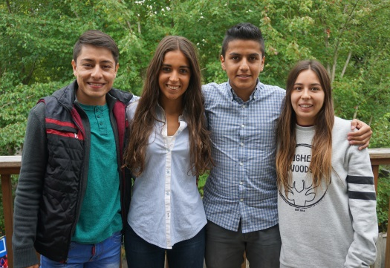
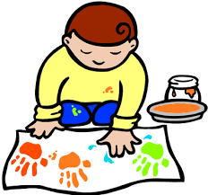
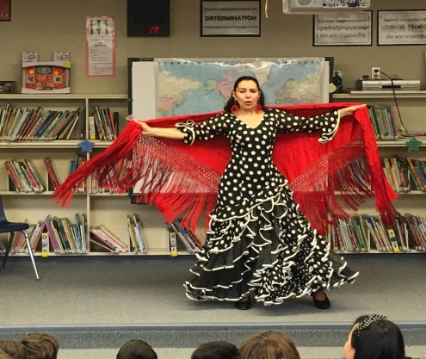
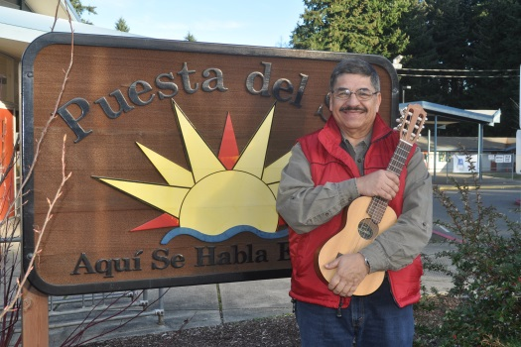
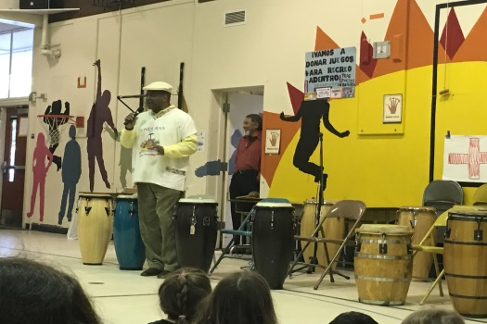
What Does PTA Do?
Puesta del Sol PTA offers a variety of programs to support and enhance the Spanish Immersion education at Puesta del Sol
Notes:
Icons are for: Amity, Art Appreciation, School Garden, Reflections, Passport, Watch DOGS, SITA (Flamenco, Marco Cortes – helped Emily Rose compose school song, Tambores)

Slide 6
How Does PTA Do It?
How do we do it all?
TOGETHER!
Human Resources
Passionate Volunteers
Financial Resources
Generous Donors
**and much more!

Slide 7
Join Us- We want YOU!
What: Sign up to become a Member
Who: Parents, Family Members, Teachers, Community Members all welcome
When: Now (or later, whenever you are ready)
Why: Voice and a vote! (Votes take place at Membership Meetings)
Plus Multiple Member Benefits
How/Where: First Day Forms (or anytime throughout year on our PTA website)
Make sure you are subscribed to the El Sol!

Slide 8
Focus on Community
Discover our Puesta del Sol Community
How?
Get the Digits!
Classroom, Bus Stop
Events
Volunteering
Points of Contact:
PTA Board
Grade-level
Neighborhood
PTA-Principal Partnership Commitment
Amy – (252)422-8172
Emily – (248)310-0847

Slide 9
Mark Your Calendars!
General Membership Meeting- Wednesday, September 27 at 6:00pm
Meet the Amity Interns
Survey Results
New Financial Aid Model Pilot
Budget and Standing Rules Approval
Walkathon- Friday, October 6 at 3:35pm
Pumpkin Bash- Friday, October 27 at 6:00pm
Auction- Saturday, March 24 2018

Slide 10
Your Teacher Will Ask For….
Volunteers In Each Classroom
It takes a village!
We look forward to getting to know you and your family this year!

