Slide 1
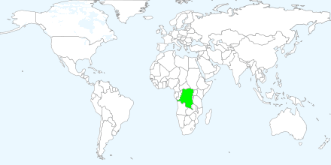
We are here. 
Notes:
The Democratic Republic of Congo is located on the continent of Africa. Africa is the second largest of the seven continents.

Slide 2
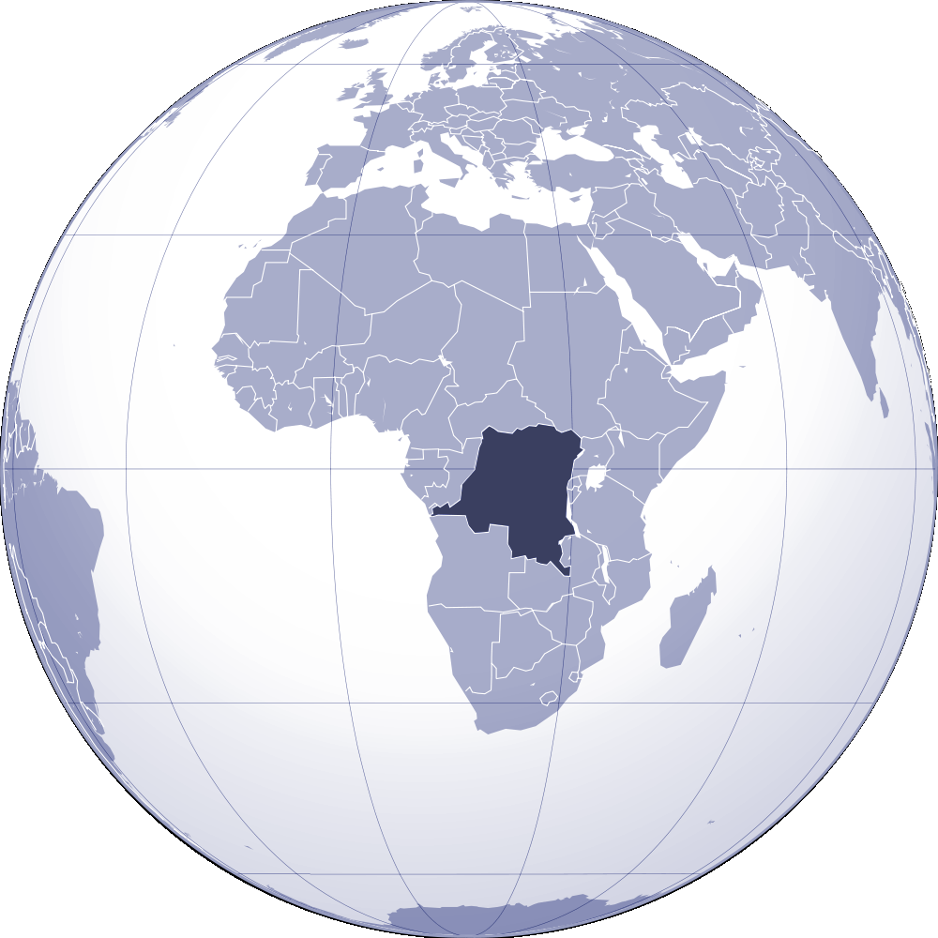
Notes:
The Democratic Republic of Congo12th largest country in the world. And the 3rd largest country in Africa. The equator runs through the Democratic Republic of Congo. The equator is imaginary line around the Earth forming a great circle that is equal distance from the north and south poles. It divides the North and South hemispheres. Countries located near the equator are warm year-round without distinct seasons. They are also very rainy and humid.

Slide 3
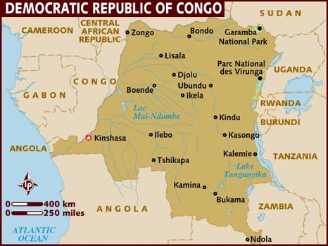

Slide 4
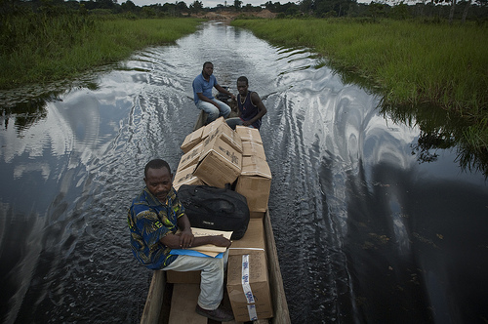

Slide 5
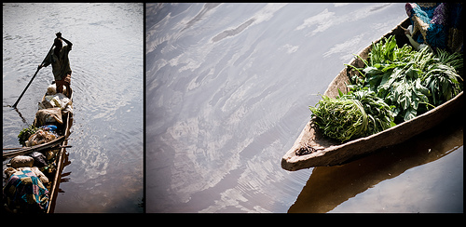

Slide 6
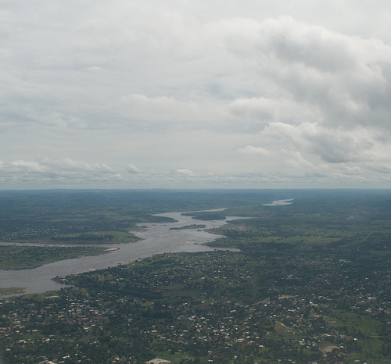
The Congo River
Notes:
The Congo River, also known as the Zaire River, is the Earth’s second largest river by volume and the largest river in Western Central Africa. Its overall length of 2,922 miles (4,700 km) makes it the second longest river in Africa after the Nile. The river and its tributaries flow through the second largest rain forest area in the world, second only to the Amazon Rainforest in South America.

Slide 7
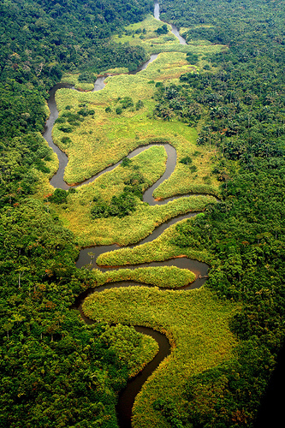

Slide 8
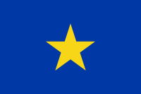
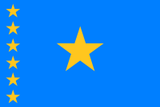
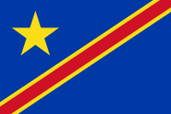
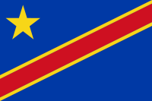
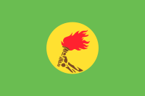
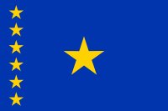
Congo Free State (1877-1908)
Belgian Congo (1908-1960)
Independence Flag (1960-1963)
1963-1966 Flag
1966-1971 Flag
Flag of Zaire (1971-1997)
1997-2003 Flag
2003-2006 Flag

Slide 9
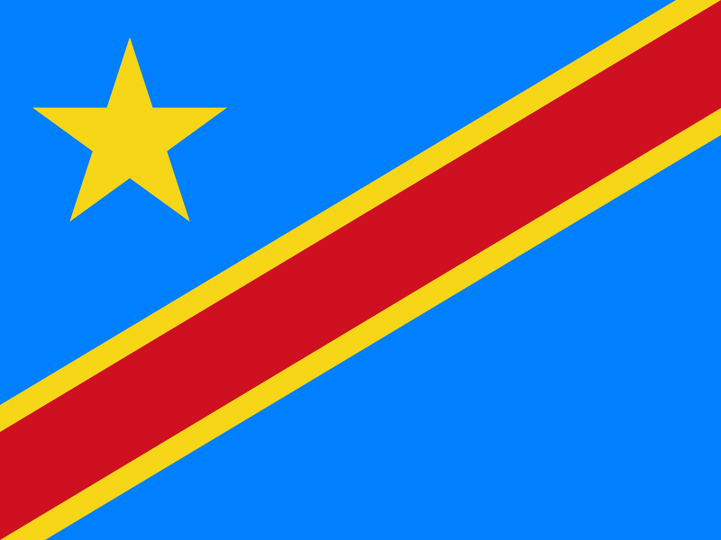
Notes:
The sky blue field divided diagonally from the lower hoist corner to upper fly corner by a red stripe bordered by two narrow yellow stripes; a yellow, five-pointed star appears in the upper hoist corner; blue represents peace and hope, red the blood of the country's martyrs, and yellow the country's wealth and prosperity; the star symbolizes unity and the brilliant future for the country. This flag was adopted in 2006 and represents the hopes for a change in a country that has had a long troubled history.

Slide 10
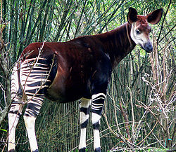
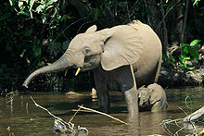
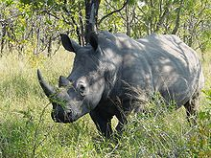
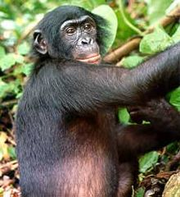
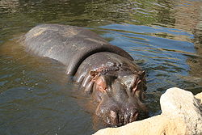
Notes:
Some animals you might find in the National Parks in Democratic Republic of Congo include the Okapi, the forest elephant, hippopotami, and the white rhino.
Due to wars, deforestation, slash and burn agriculture practices and hunting the parks and the animals in the DRC are threatened.

Slide 11
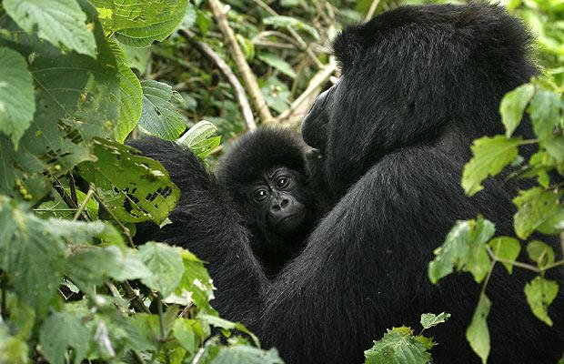
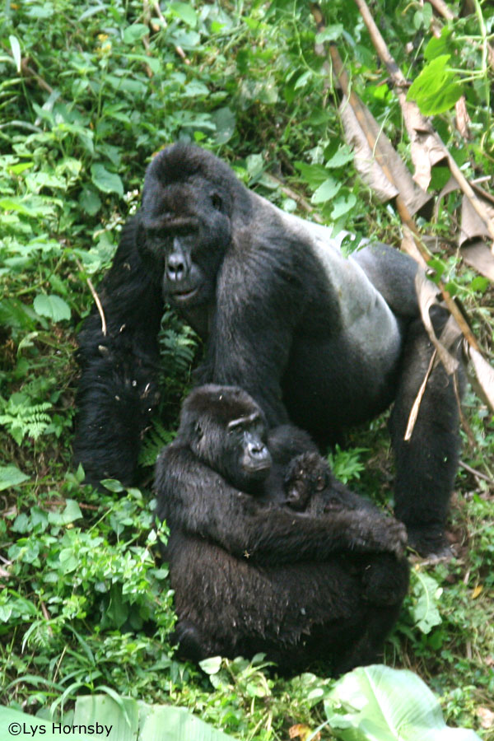
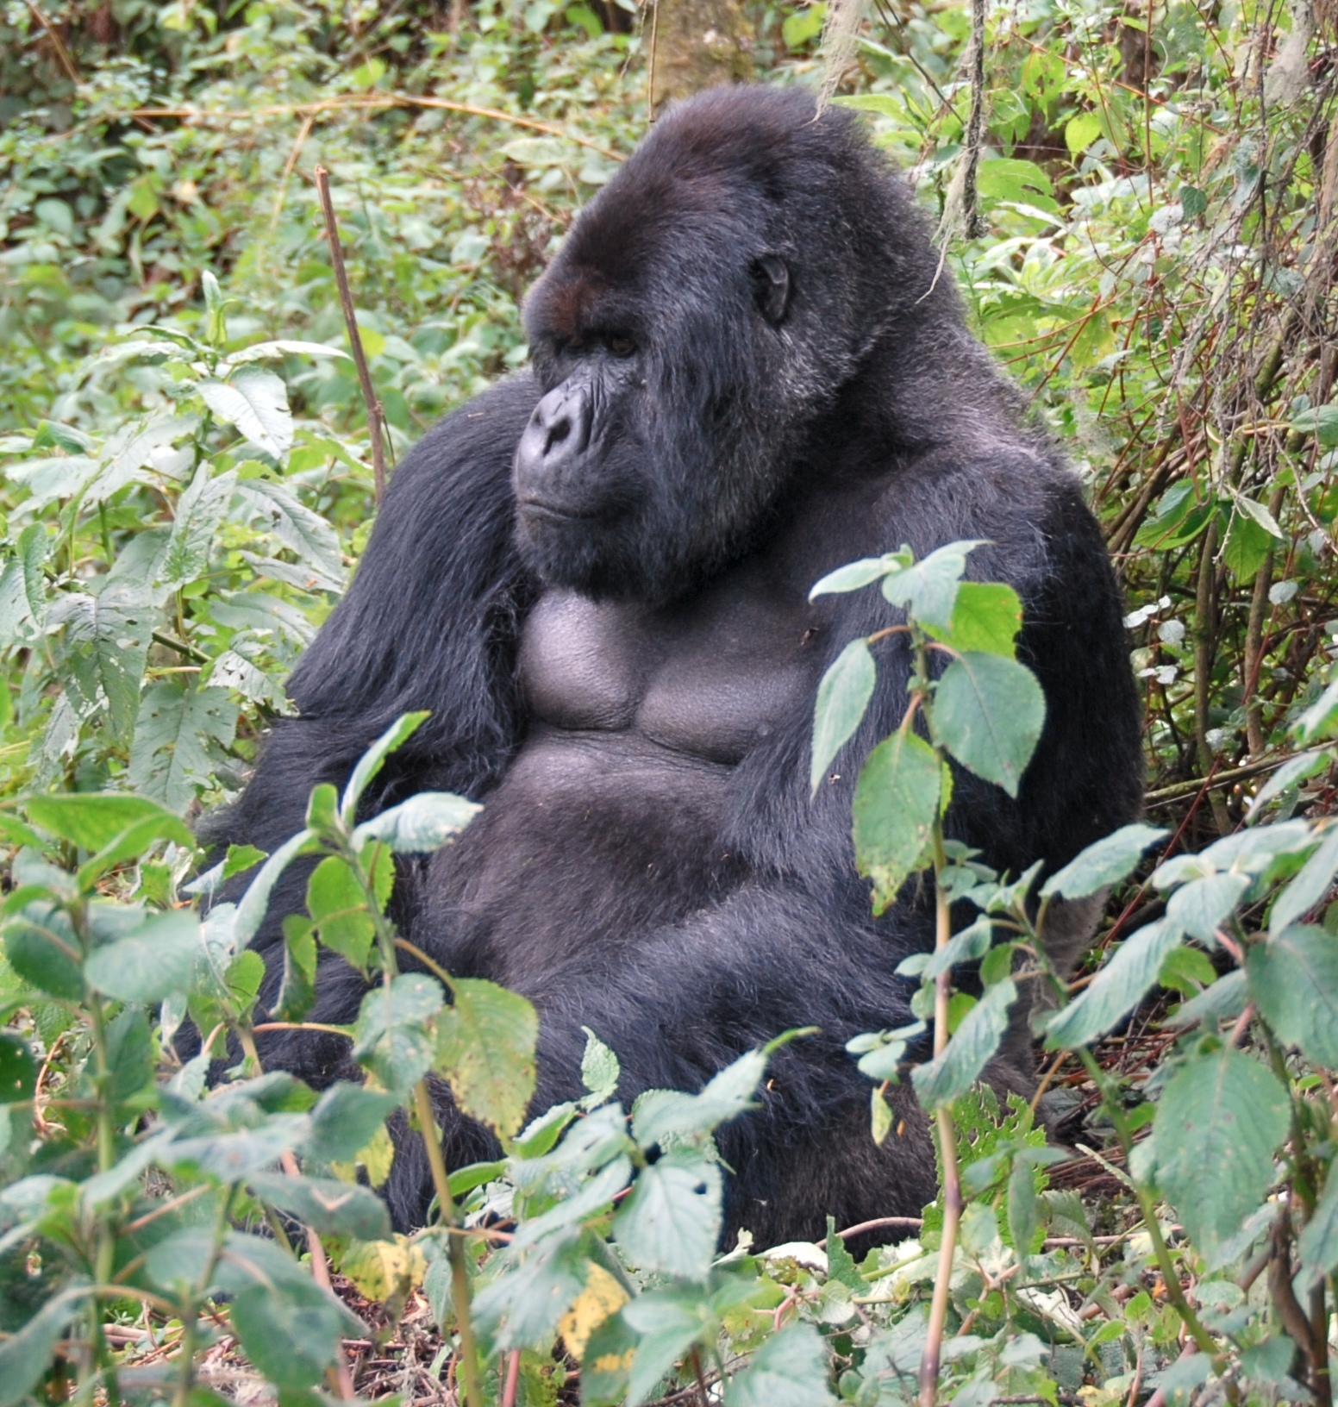
Notes:
One of the most well-known and endangered animals in the Democratic Republic of Congo are the mountain gorillas. There are only about 700 mountain gorillas remaining on Earth and nearly half of them live in the forest of the Virunga mountains in central Africa.

Slide 12
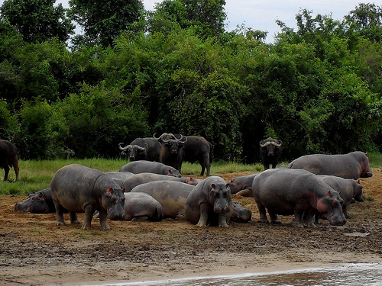
Notes:
Hippos and buffalos in Virunga National Park;

Slide 13
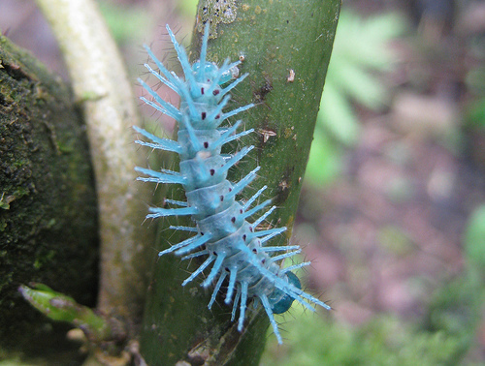
Notes:
Chenille

Slide 14
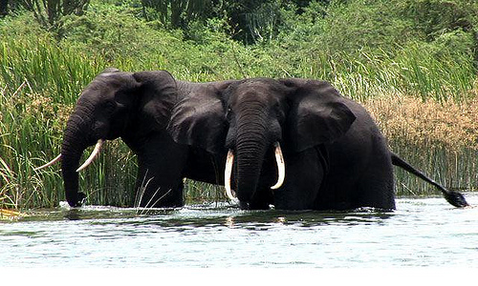
Notes:
Forest elephants in Virunga National Park

Slide 15
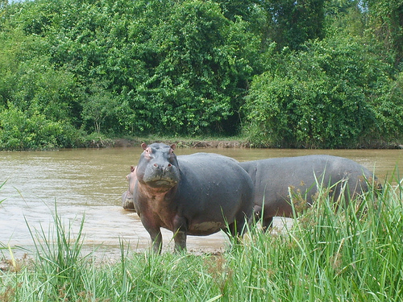
Notes:
Hippos in Virunga National Park

Slide 16
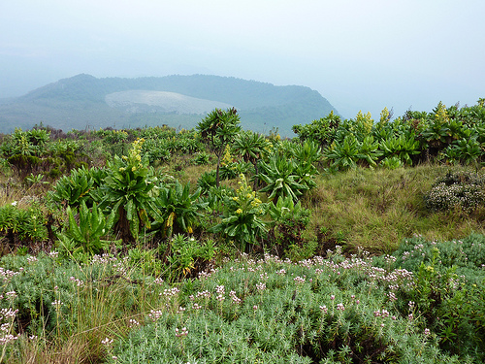
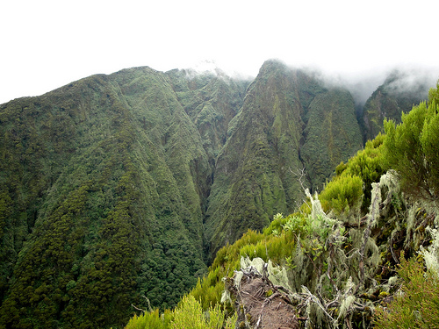
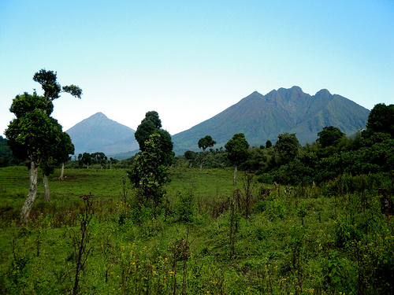
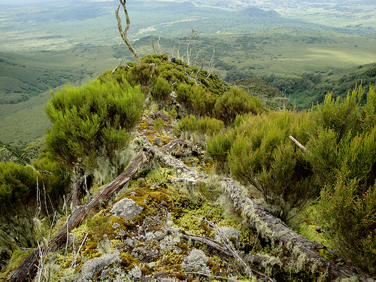
Notes:
Virunga is Africa's oldest and most diverse national park. It is a World Heritage Site because it is beautiful, because it contains volcanoes and because it provides habitats and security for endangered species. The park has suffered the effects of war, population explosion, climate change, crime and spite; it has been invaded, occupied, ransacked and depleted.

Slide 17
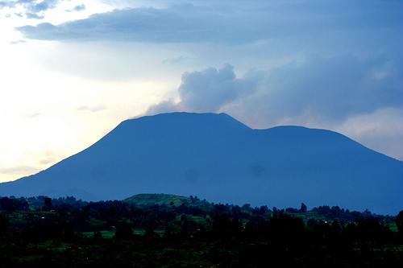
Notes:
Two of the most active African volcanoes are located in the Democratic Republic of Congo. There are Nyamuragira (shield volcano) and Nyiragongo (stratovolcano or composite volcano). This is a photo of the Nyiragongo volcano.

Slide 18
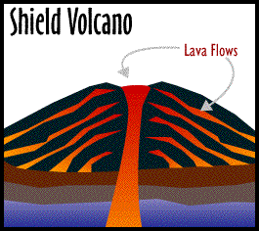
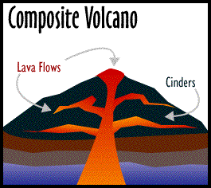
Types of Volcanoes
Nyamuragira
Mt. Kilauea
Mauna Loa
Nyiragongo
Mt. Rainer
Mt. Hood
Notes:
A volcano is an opening in the Earth’s surface (crust), which allows hot magma, ash, and gases escape from below the surves. They are typically found where tectonic plates either come together (converge) or are moving apart (diverge). Shield volcanoes are named for their broad shield-like profile. The lave flows a great distance from the vents; but generally these types don’t explode catastrophically. Composite volcanoes the type we think of when we think about the word volcano. They are made up of layers (strata) of ash, cinders and lava. These are the type of volcanoes that are most dangerous when they explode.
Volcanoes are classified not just by shape; but by the frequency of eruptions. Those that erupt regularly are called active, those that have erupted in historical times are called dormant and those that have not erupted in historical times are called extinct.

Slide 19
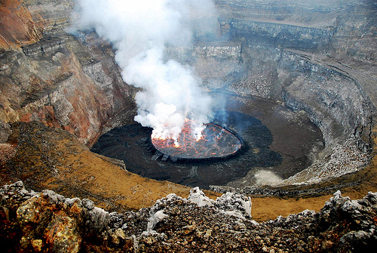
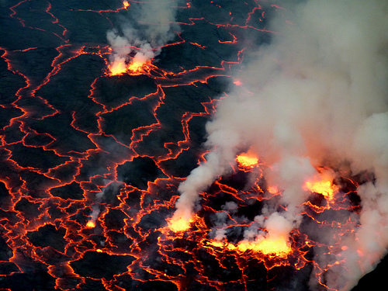
Notes:
Lava Lakes in Nyiragongo volcano.

Slide 20
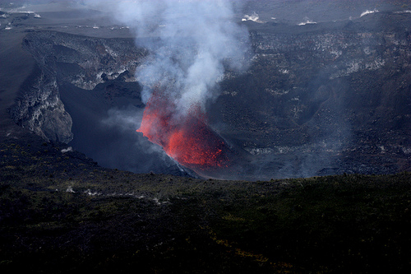

Slide 21
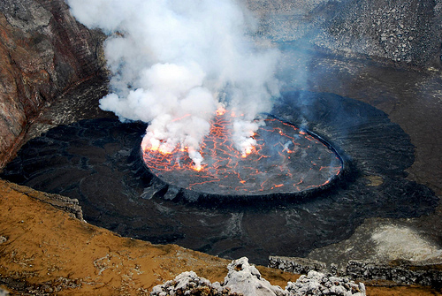
Notes:
Nyiragongo Lava Lake #2

Slide 22
Notes:
The sky blue field divided diagonally from the lower hoist corner to upper fly corner by a red stripe bordered by two narrow yellow stripes; a yellow, five-pointed star appears in the upper hoist corner; blue represents peace and hope, red the blood of the country's martyrs, and yellow the country's wealth and prosperity; the star symbolizes unity and the brilliant future for the country. This flag was adopted in 2006 and represents the hopes for a change in a country that has had a long troubled history.

Slide 23
Facts About the Democratic Republic of Congo
Population: 68 million, 2010 (compared to the US which has 350 million).
Capital: Kinshasa
Area: 905,354 sq miles (the United States is 3,794,101 square miles).
Major languages: French, Lingala, Kiswahili, Kikongo, Tshiluba
It is the largest French-speaking country.
Major religions: Christianity, Islam
Life expectancy: 46 years (men), 49 years (women)
Money: Congolese franc
Main exports: diamonds, copper, coffee, cobalt, crude oil
Agricultural products: Coffee, sugar, palm oil, rubber, tea, quinine, cassava, bananas.
Most agriculture is subsistence level.
Formerly called: The Congo Free State, Belgian Congo, Congo-Léopoldville, Congo-Kinshasa and Zaire
Notes:
The US is 4x larger than Democratic Republic of Congo with about 5x more people.
The Democratic Republic of Congo is a very poor country. It does not have a lot of infrastructure (roads, hospitals, stores, airports). For example, there are only 37,300 telephones in the country (126,000 people in Bellevue). They do have many more cell phone: 9.8 million. They have 198 airports; but only 26 of them have paved runways. Most of their roads are unpaved. The waterways are the dominant means of transport.
In 1996 the First Congo War started and in 1998 the Second Congo War began. The Second Congo War is also called the African World War because it involved 8 African nations and killed 5.4 million people. The deadliest conflict since World War II. Even though peace accords were signed in 2003, there is still a lot of fighting going on in the country.
It is a country that is rich in natural resources. Lots of minerals, water, oil. It is also most bio-diverse country in Africa.

Slide 24
National Parks in Democratic Republic of Congo
Garamba National Park, UNESCO World Heritage Site
Known for the last wild herd of White Rhinos
Kahuzi- Biéga National Park, UNESCO World Heritage Site
Named after two extinct volcanoes and home to the rare Eastern Lowland Gorilla
Maiko National Park
Located in one of most remote forests in the DR Congo. It is home to the Eastern Lowland Gorilla, the Okapi and the Congo Peacock—all endemic to the region.
Okapi National Park, UNESCO World Heritage Site
In the Ituri Forest. Home to the Okapi and a breeding program for zoos.
Salonga National Park, UNESCO World Heritage Site
Located in the Congo River basin. It is Africa’s largest rainforest reserve.
Upemba National Park
Located in the Kibara Plateau and home to 1,800 species.
Virunga National Park, UNESCO World Heritage Site
Africa’s first National Park established in 1925. Known for its exceptional diversity including mountain gorillas, hippopotami, active volcanoes and lava plains.
Notes:
There are 7 National Parks in the DR Congo. Five of them are World Heritage Sites. World Heritage Sites are considered have outstanding universal value.
Endemic: To be endemic to a place or area means that it is found only in that part of the world and nowhere else.

