Slide 1
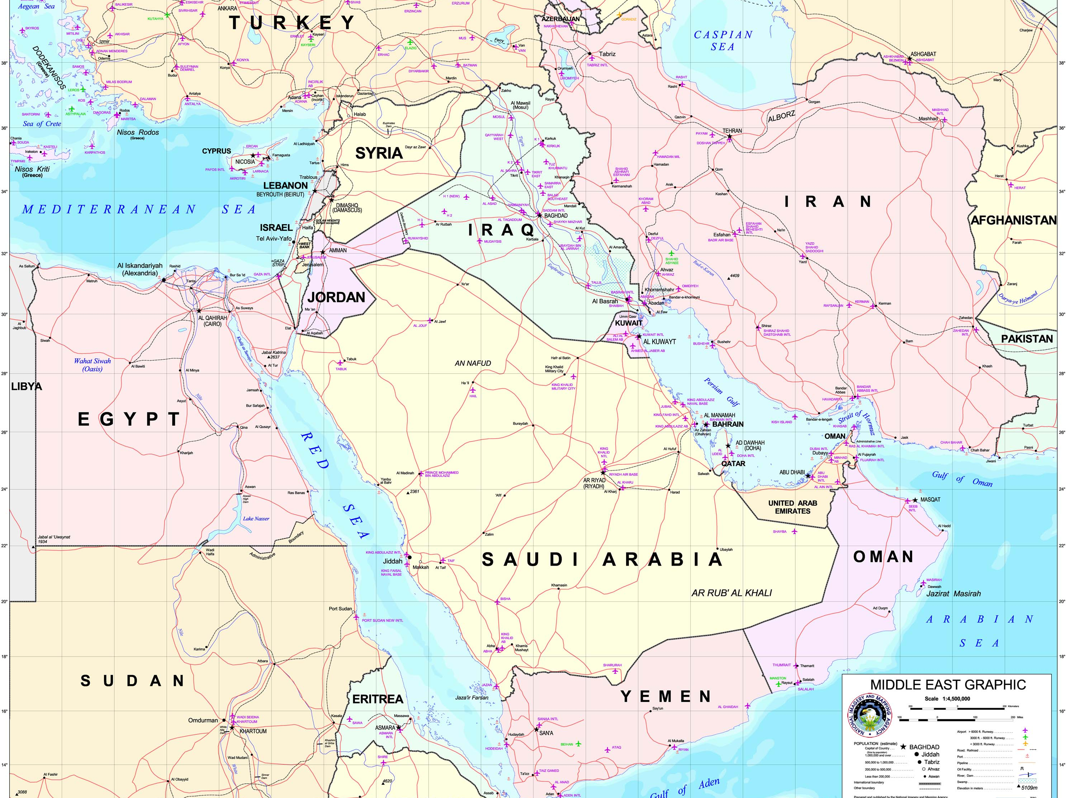
Where is Israel?

Slide 2
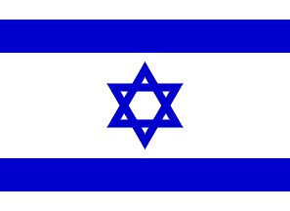

Slide 3
Important Information
Capital: Jerusalem
Largest City: Jerusalem
Amount of People: 7,825,600 [97th ]

Slide 4
What language is spoken?
Spanish
Zulu
Hebrew
Portuguese
French

Slide 5
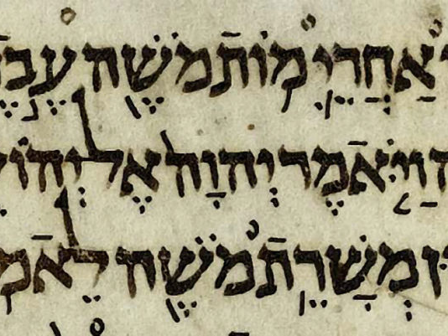
What Language?
Hebrew!

Slide 6
Religions
Jewish: 75.3%
Arab: 20.5%
Other: 4.2%

Slide 7
When did Israel declare its independence?
The state of Israel declared its independence on May 14, 1948, after their "civil war".

Slide 8
How long has the land of Israel existed?
Since 1200 BC….

Slide 9
What wars was Israel involved in?
14 wars – The most famous were…
1948 Arab–Israeli War (November 1947 - July 1949)
Suez Crisis (October 1956)
Six-Day War (June 1967) – Golan Heights, Sinai, Gaza and West Bank
Yom Kippur War (October 1973)
South Lebanon conflict (1982–2000)
First Intifada (1987–1993)

Slide 10
History of Jerusalem
During its long history, Jerusalem has been destroyed twice, besieged 23 times, attacked 52 times, and captured and recovered 44 times. The oldest part of town was settled in the fourth millennium BC, making Jerusalem one of the oldest cities in the world. The old walled city, a World Heritage Site, has traditionally been divided into four quarters, although the names used today, the rooms were Armenian Christians, Jews and Muslims introduced in the 19th century.

Slide 11
History of Jerusalem
Today, the status of Jerusalem remains one of the central issues in the Israeli-Palestinian conflict.
Israel captured East Jerusalem during the 1967 Six Day War and later annexed it. Currently, the Basic Law of Israel regards Jerusalem as "indivisible capital" of the country. The international community does not recognize Jerusalem as Israel's capital and the city hosts no foreign embassies.

Slide 12
The Old City of Jerusalem
Jerusalem is a holy city to the three major religions : Judaism, Christianity, and Islam
The Old City is home to sites of key religious importance, among them the Temple Mount, the Western Wall, the Church of the Holy Sepulchre, the Dome of the Rock and al-Aqsa Mosque.

Slide 13
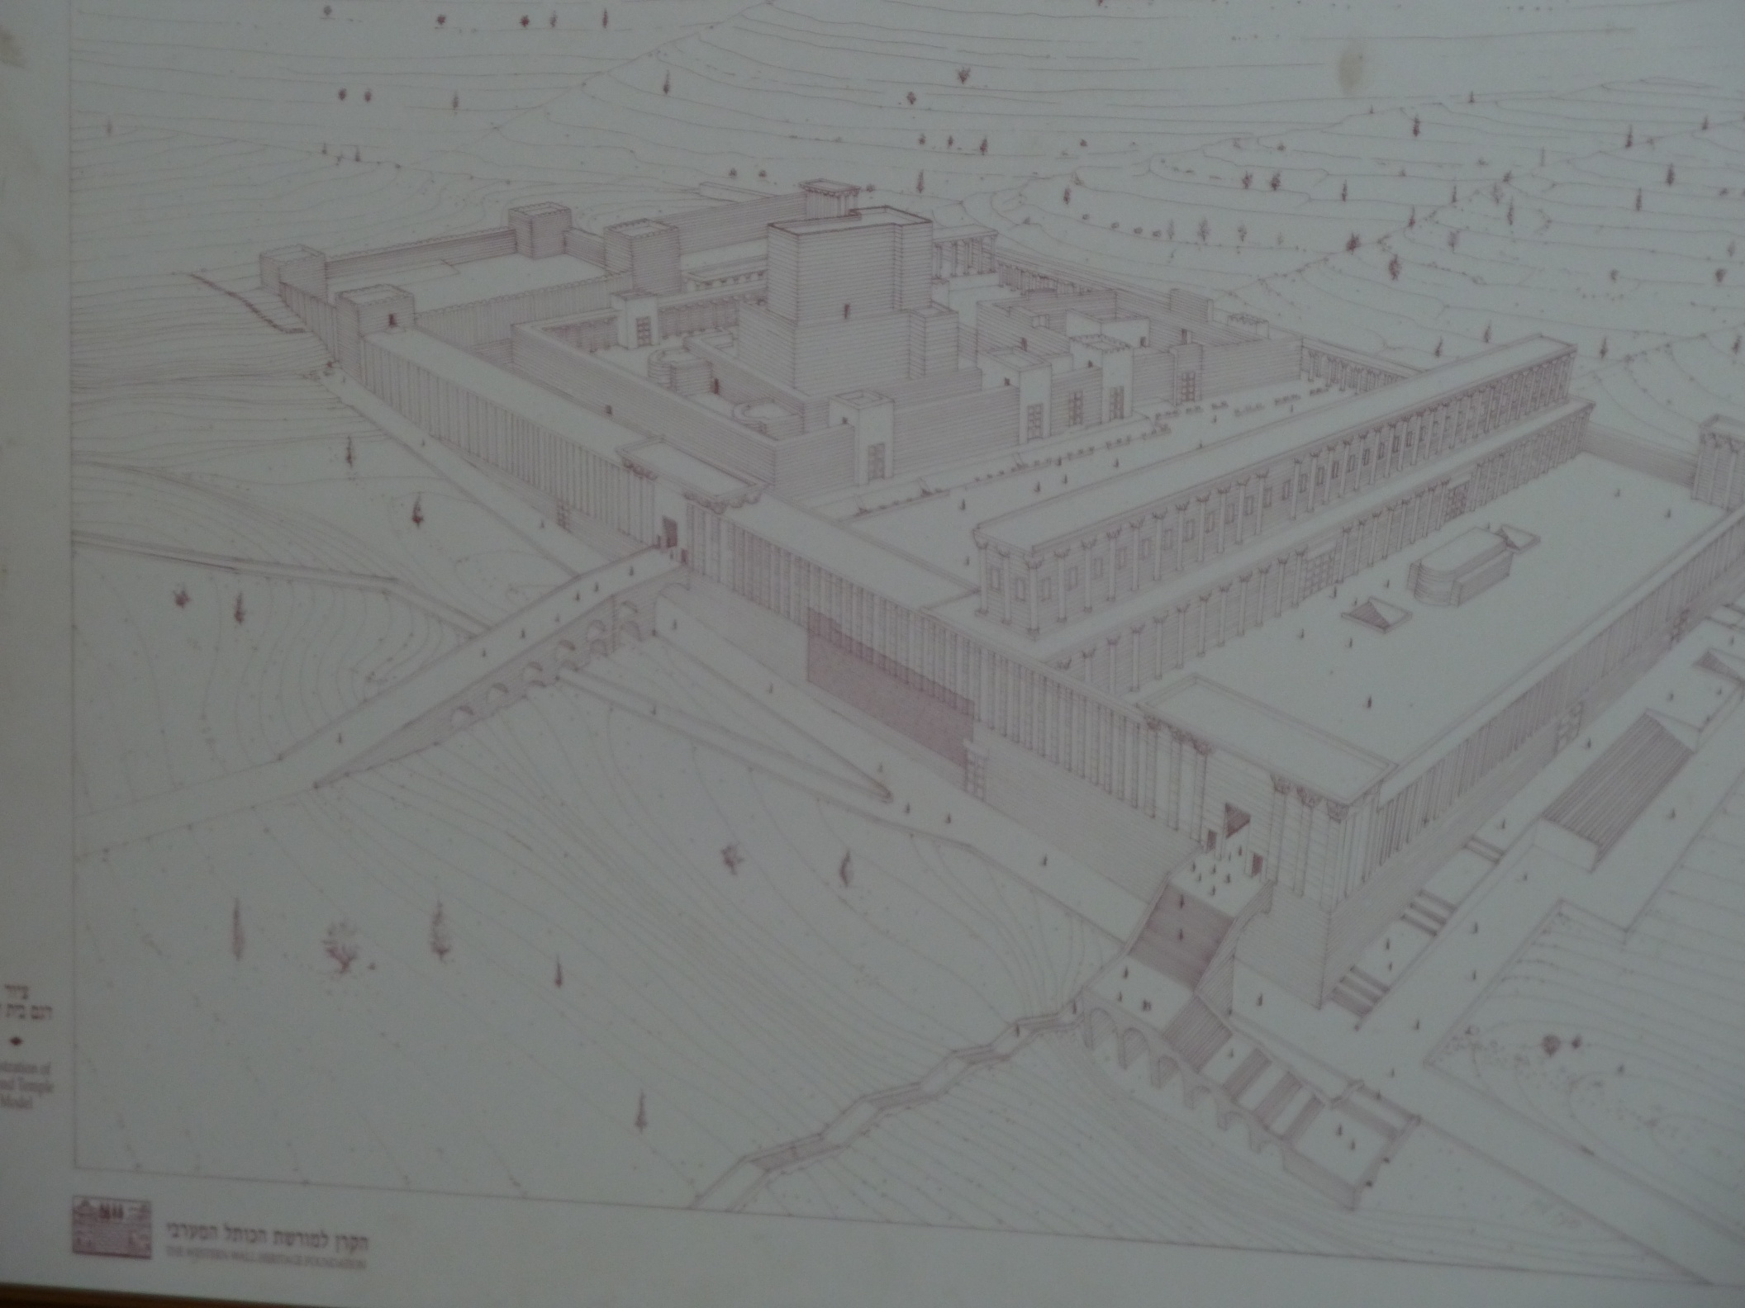
Map of First Temple

Slide 14
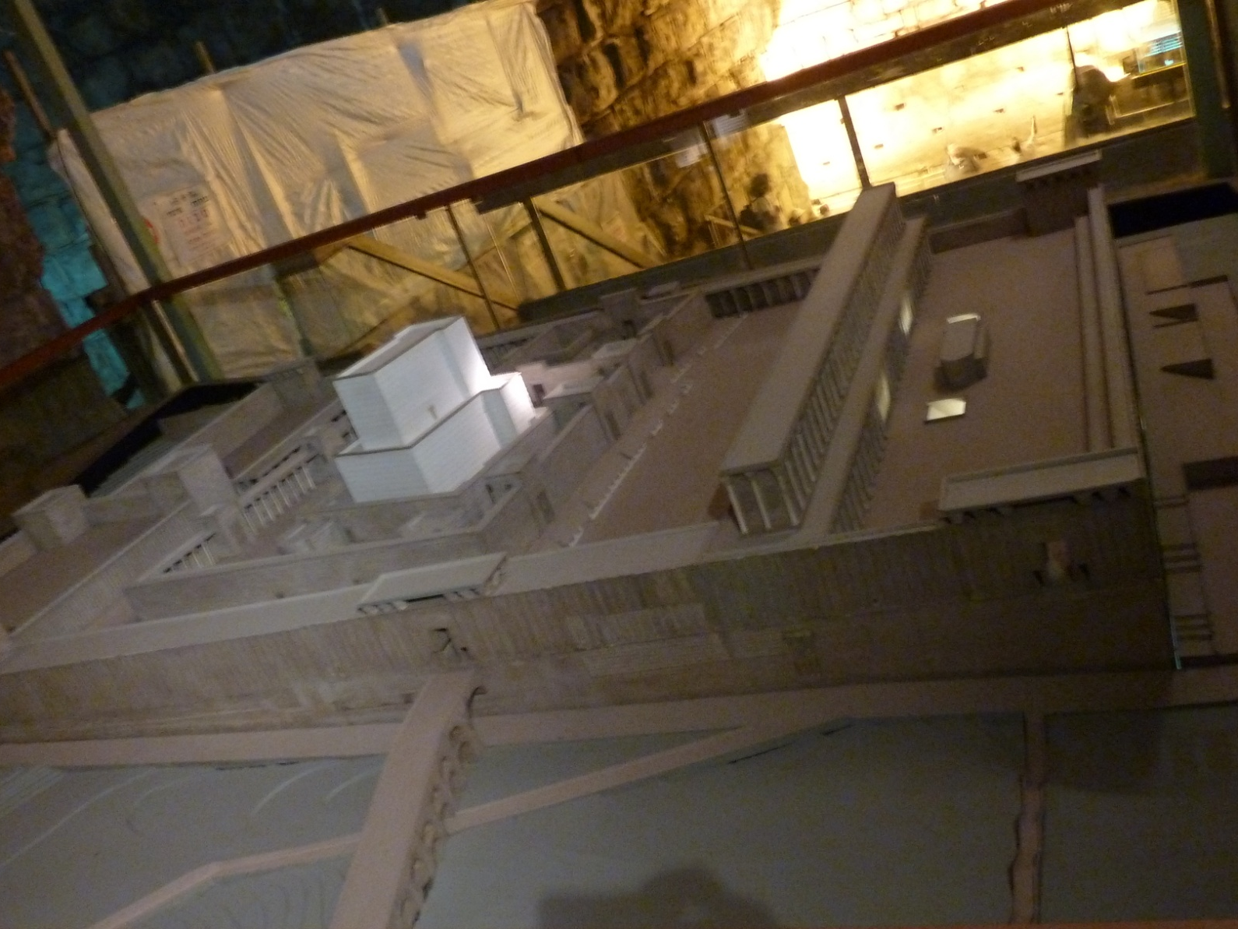
Model of First Temple that was destroyed

Slide 15
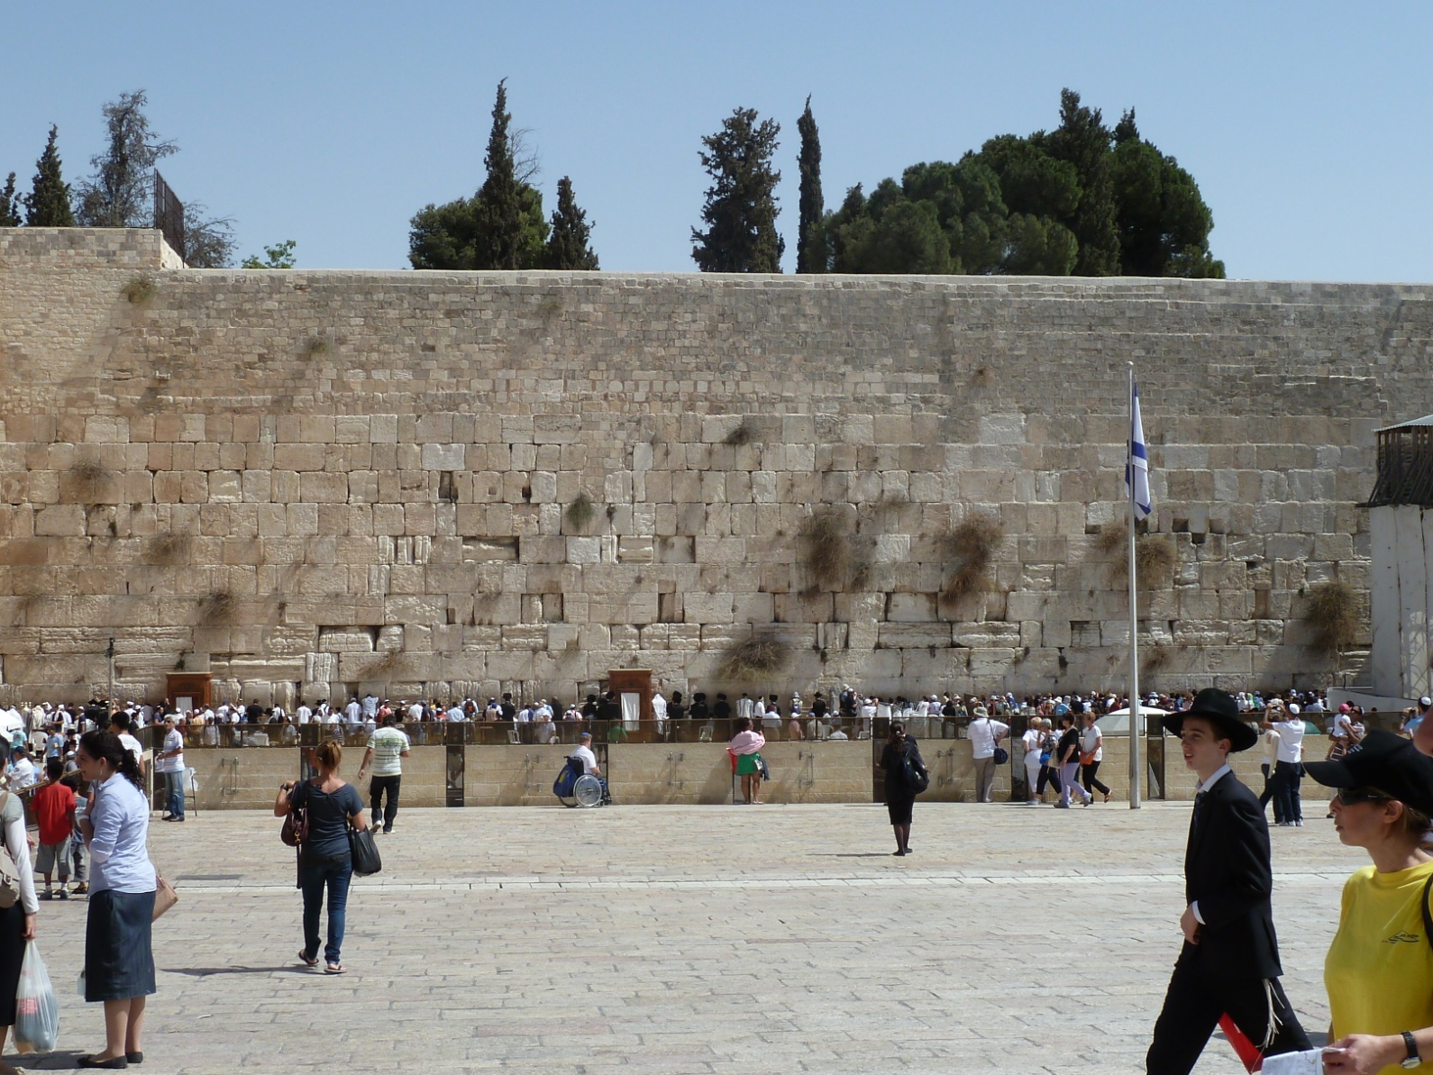
Western Wall up close

Slide 16
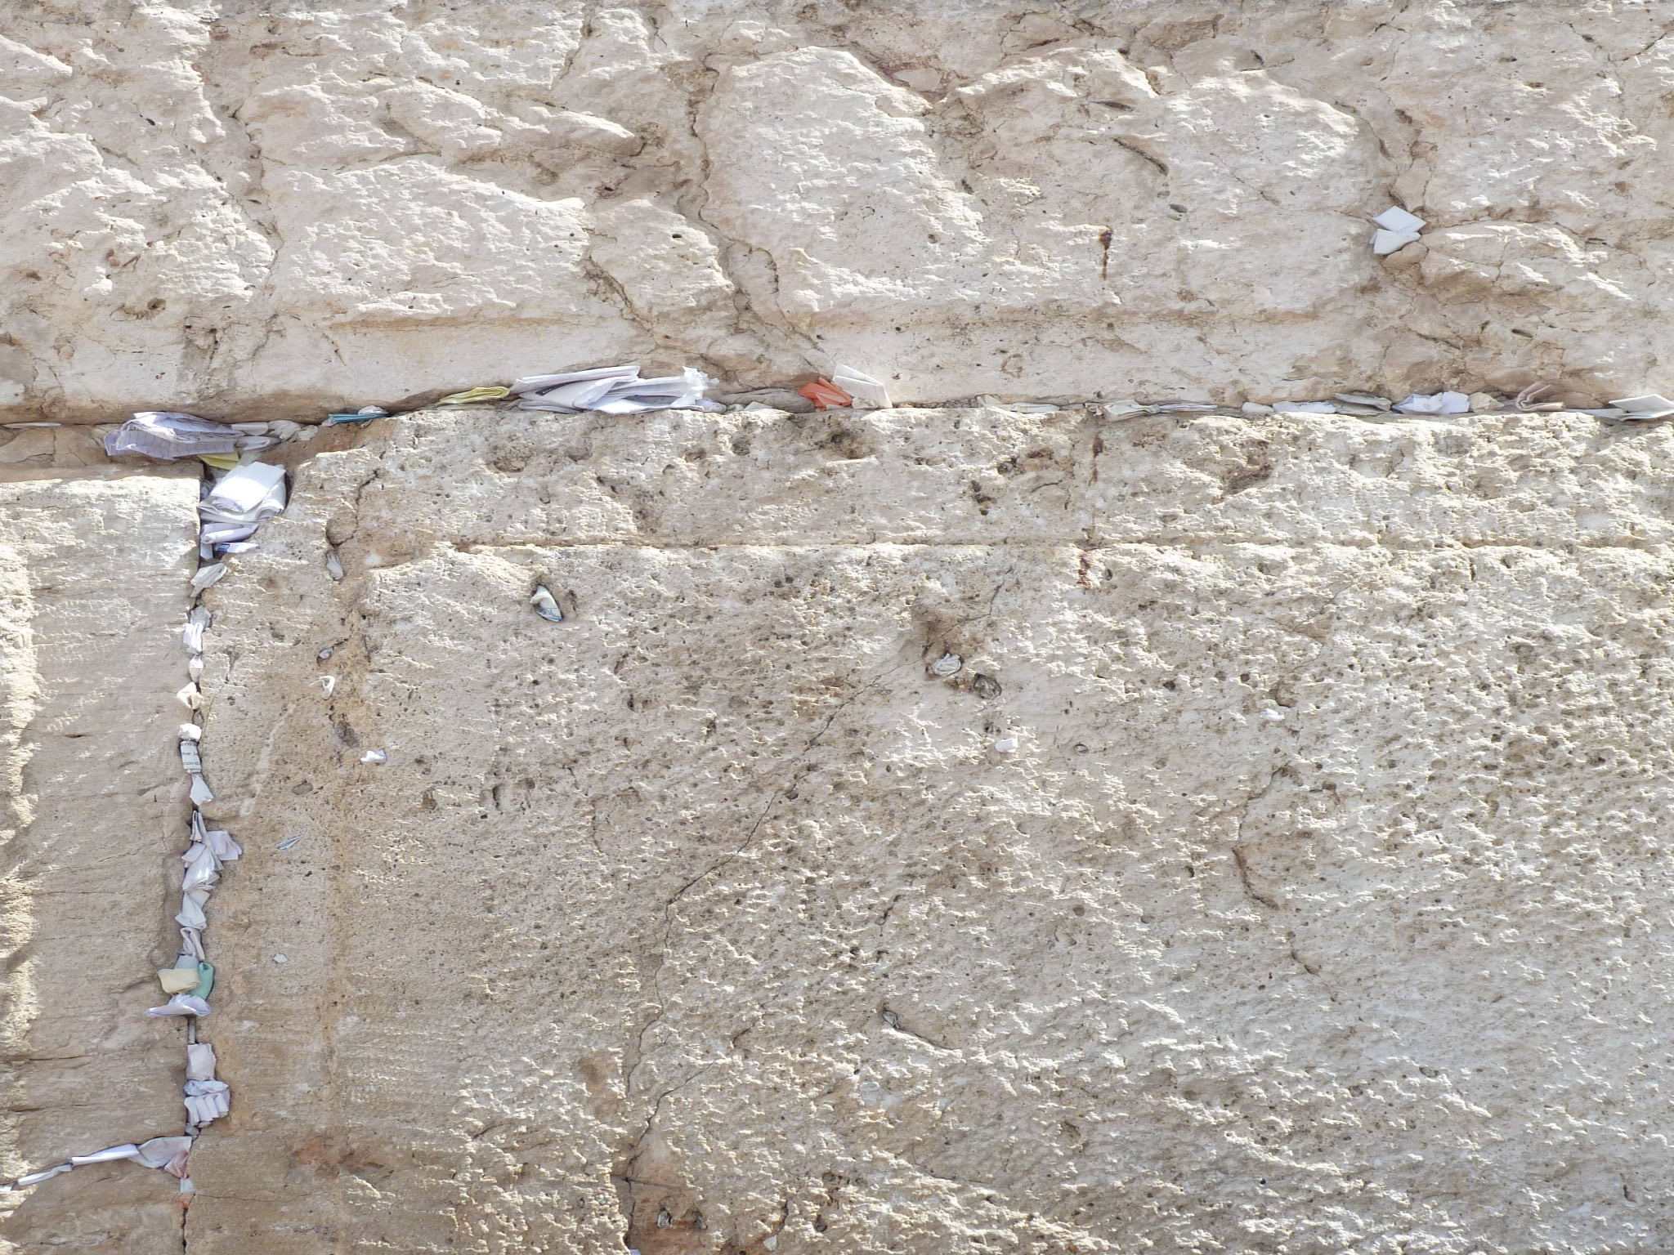
Prayer Notes in Western Wall

Slide 17
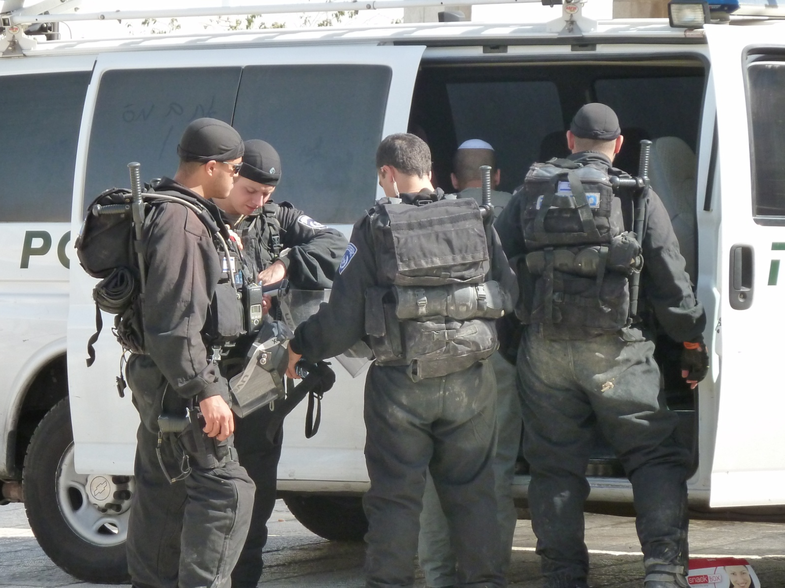
IDF Soliders (Israel Defense Force)

Slide 18
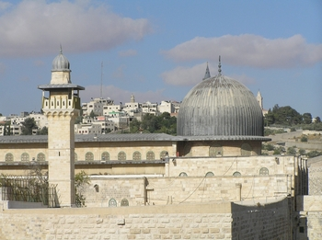
Al-Asqu Mosque – Muslim Quarter

Slide 19
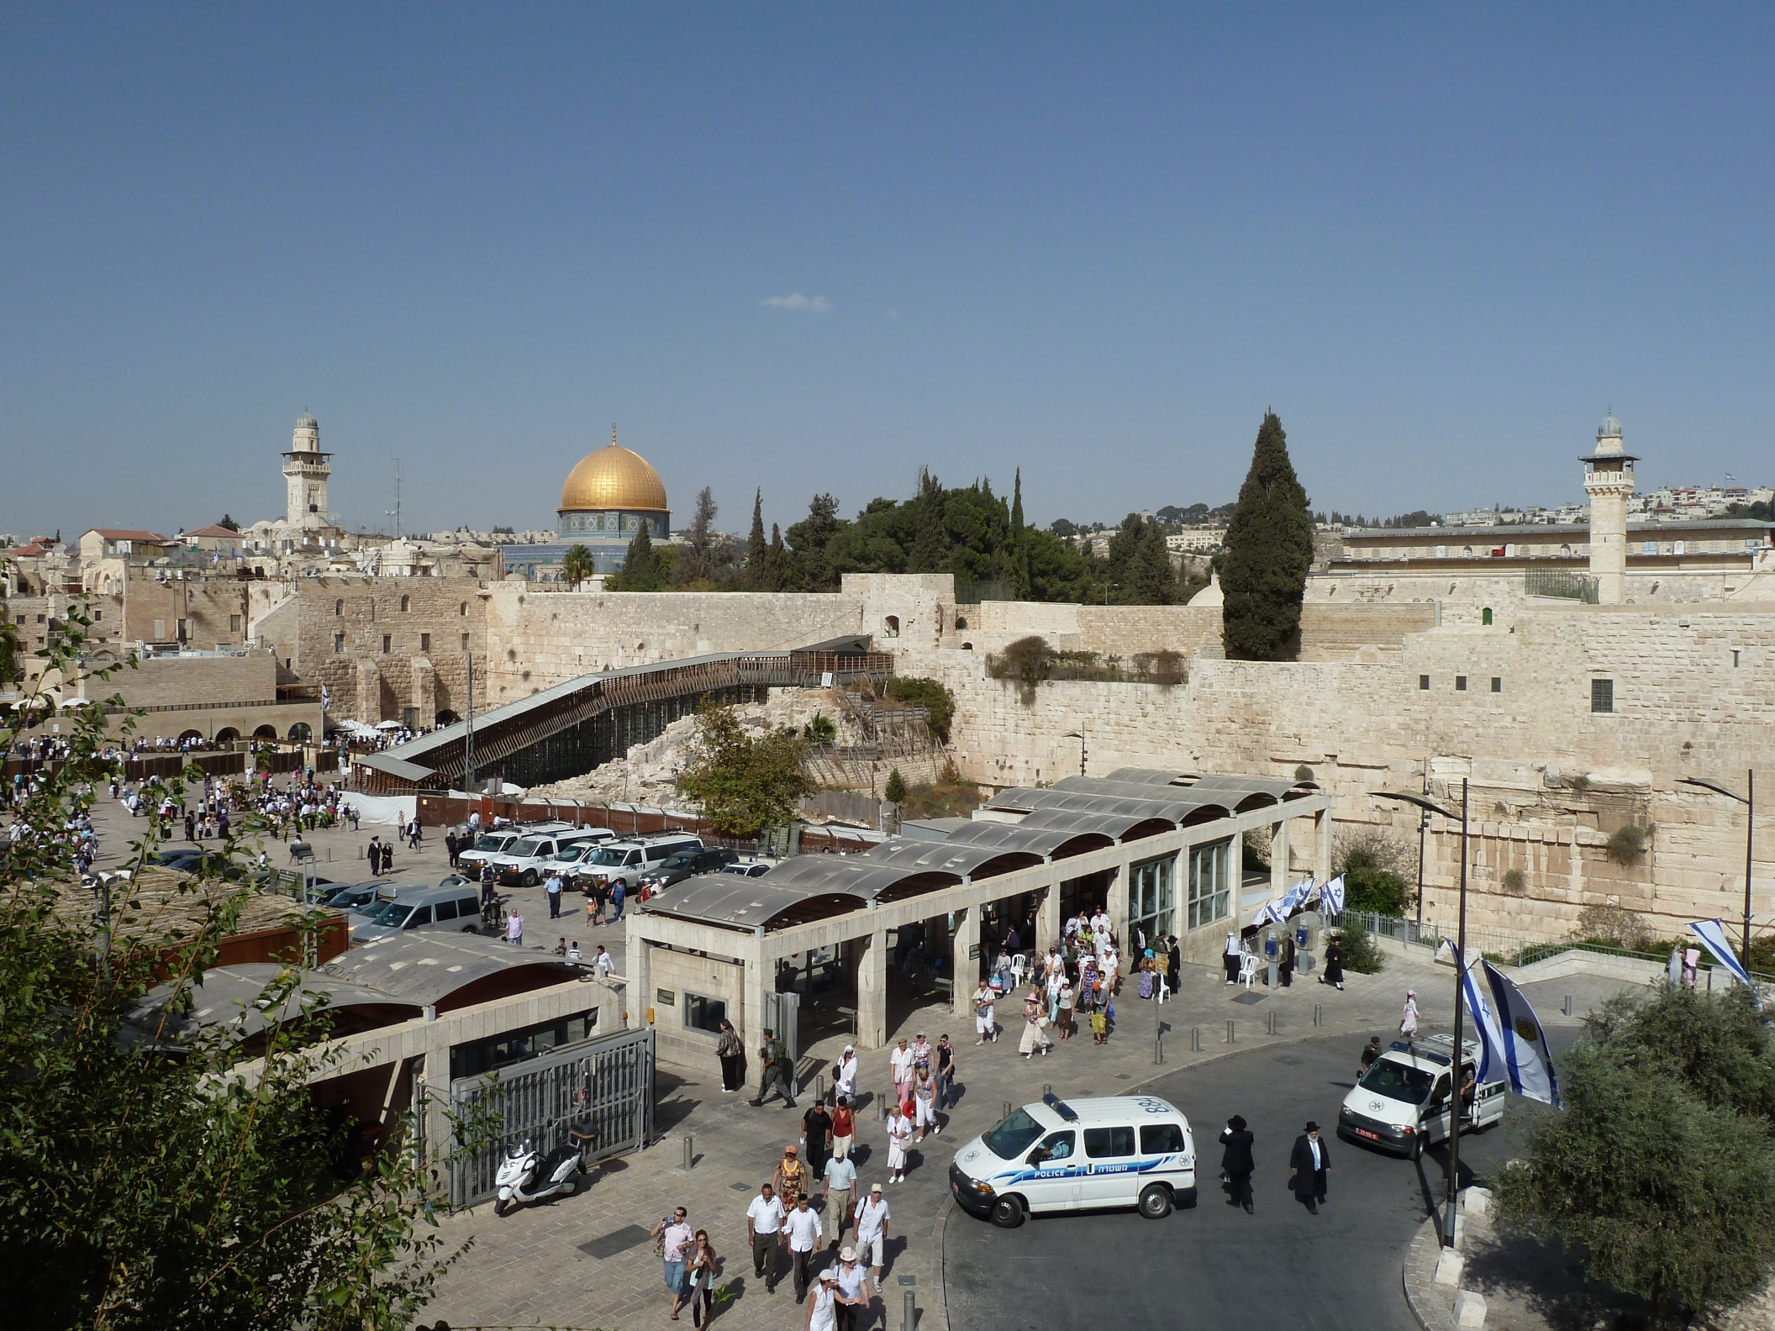
The Temple Mount – The Muslim Quarter

Slide 20
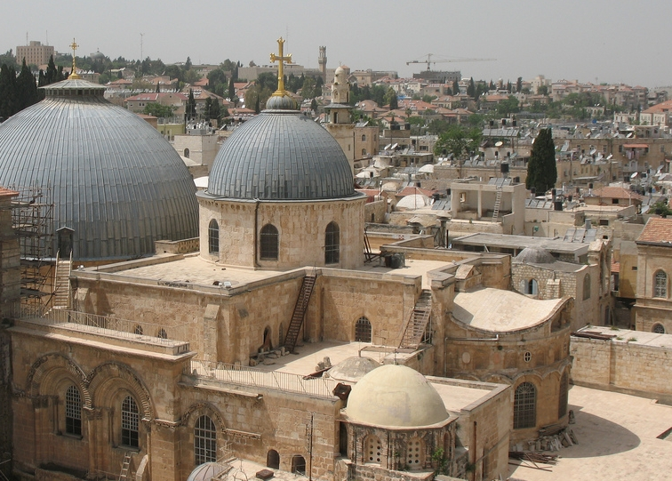
The Church of the Holy Sepulchre

Slide 21
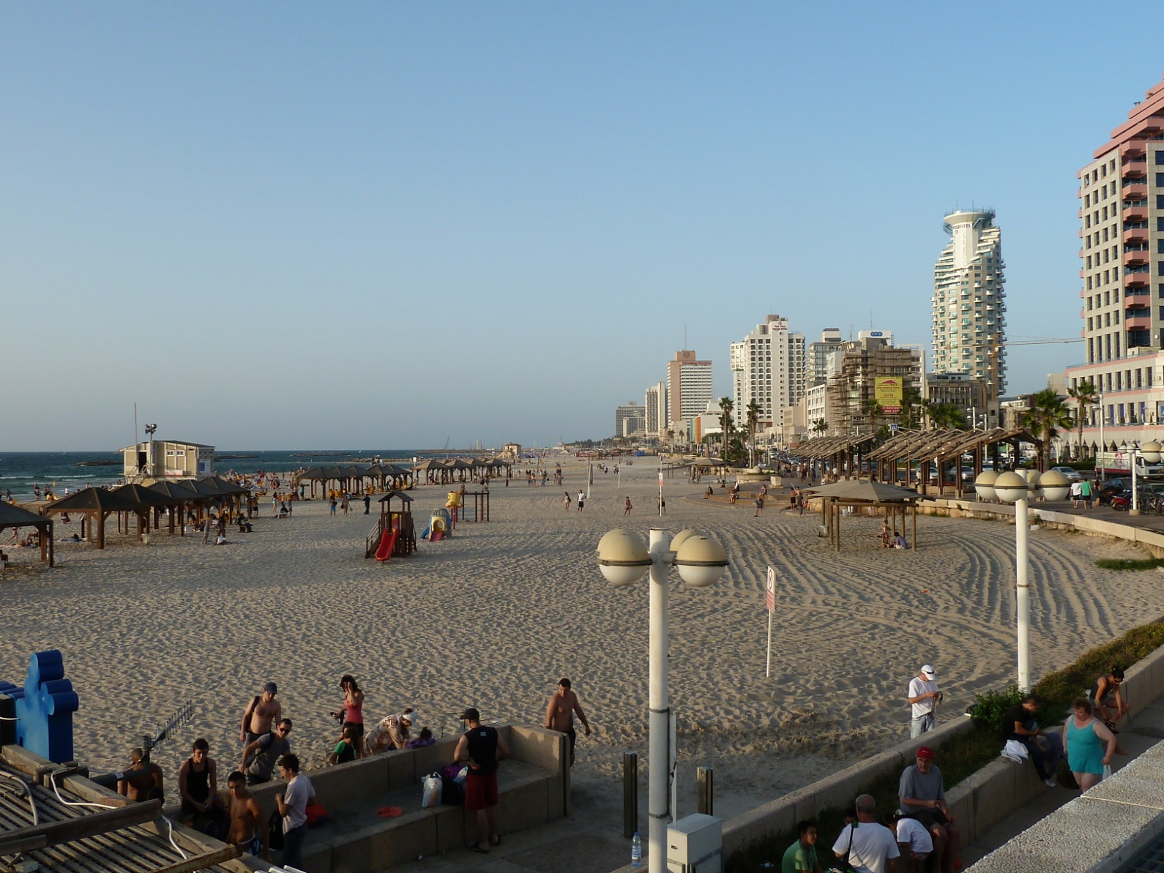
Mediterranean Sea in Tel Aviv

