Slide 1
JAPAN
The Language, Culture and Food
By Emi and Her Family:
Grandmother “Baaba” Yoshiko
Dad “Otousan” Ken
Mom “Okaasan” Renee
Sister “Imouto” Mika

Slide 2
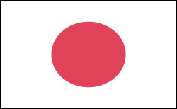
What do you know about Japan?

Slide 3
Japanese Greetings & Bow
Good morning – Ohayo
Good afternoon – Konnichiwa
Hello (on the telephone) - Moshi Moshi
Thank you – Arigato
Goodbye – Sayonara

Slide 4
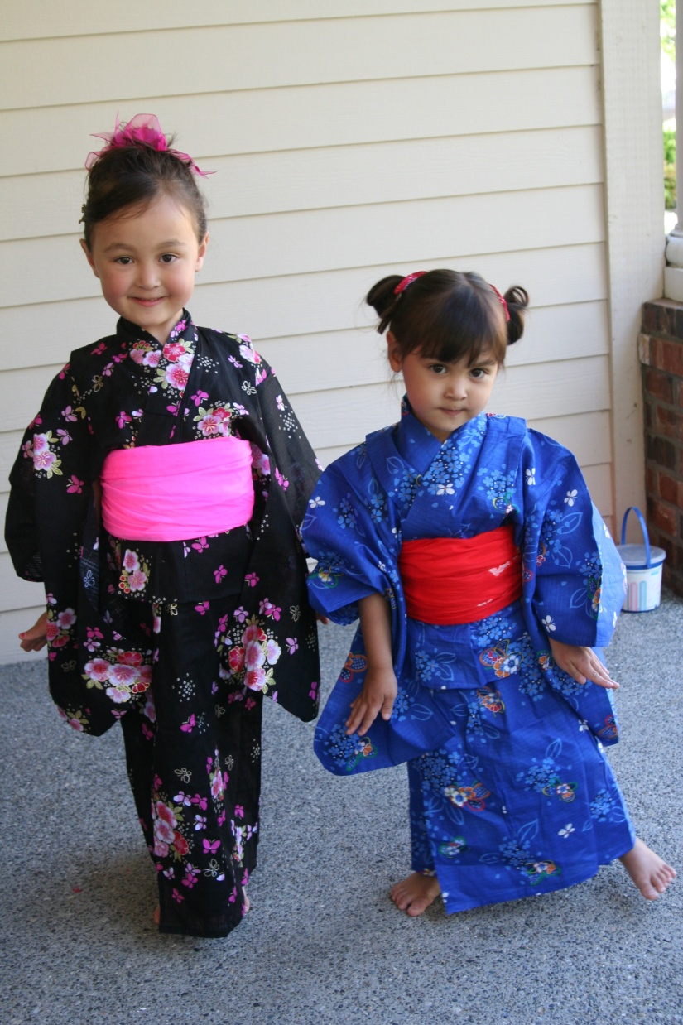
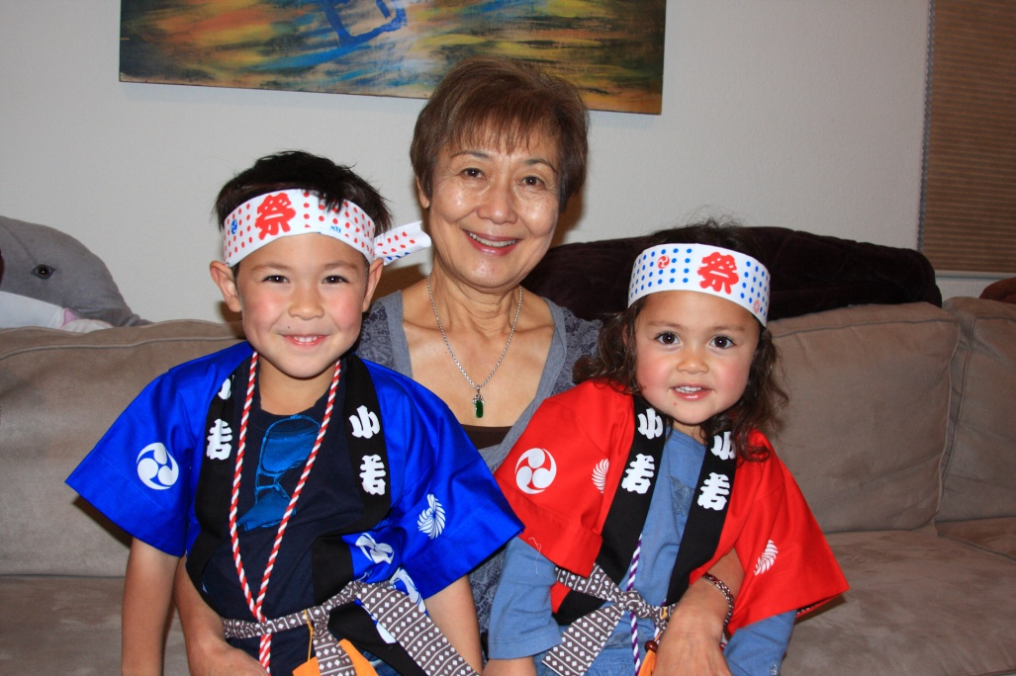
Japanese Clothing
Emi’s Baaba and her cousins. Kai and Kira are dressed in hapi, festival wear.
Emi and Mika dressed in yukata, cotton kimonos

Slide 5
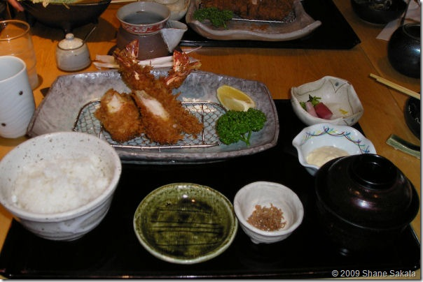
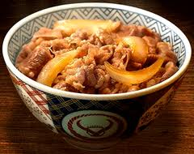
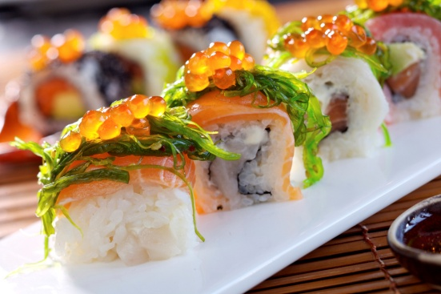
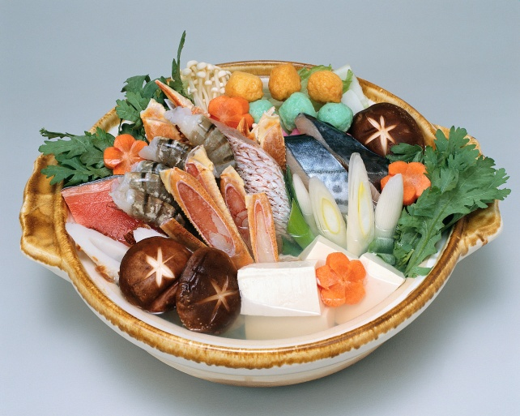
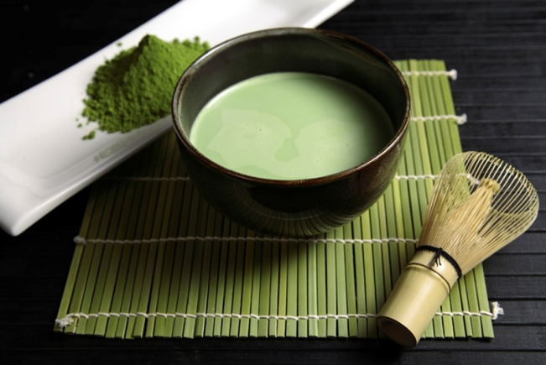
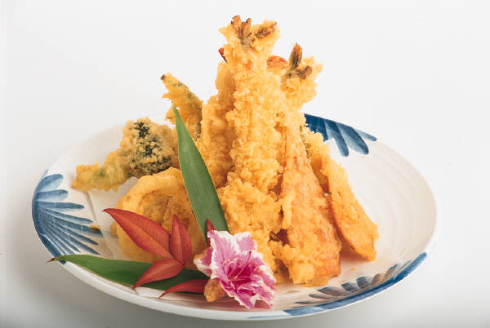
Japanese Food

Slide 6
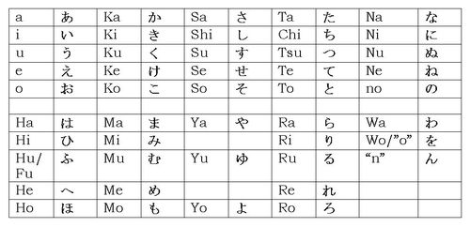
Japanese Writing
3 Types of Japanese Writing
  Hiragana あ い う え お
  Katakana ア イ ウ エ オ
  Kanji (Chinese) Characters 山 川 雨
  Emi’s Name in all three types of writing:
  えみ エミ 笑美

Slide 7
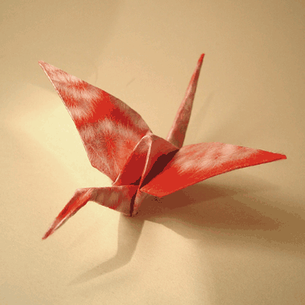
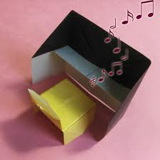
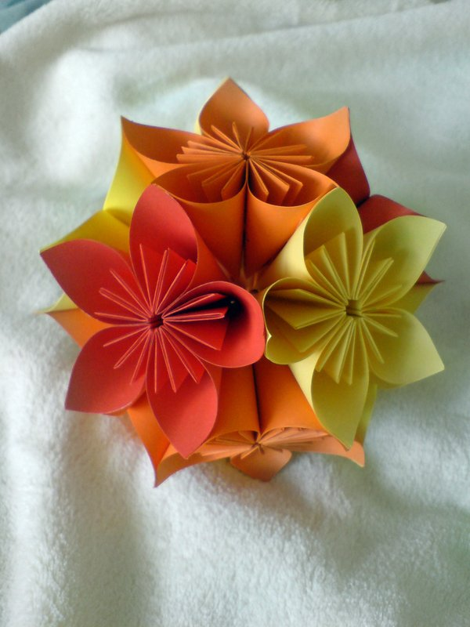
Origami - Japanese

Slide 8
Japanese Songs
Ito Maki Maki
(Wind the thread, i.e. a bobbin for sewing)
  Ito maki maki
  Ito maki maki
  Hiite hiite ton, ton, ton
  Ito maki maki
  Ito maki maki
  Hiite hiite ton, ton, ton
  Dekita, dekita,
  Jyozu ni dekita!
Atama Kata Hiza Pon
(Head, Shoulders, Knees & “Pon”)
  Atama kata hiza pon
  Hiza pon, hiza pon
  Atama kata hiza pon
  Atama kata hiza pon
  Me, mimi, hana, kuchi

Slide 9
It’s your turn to experience
Japanese culture!
Four stations:
Origami, Paper-Folding
Chopstick Racing
Snack Tasting
Japanese Matching and Writing Practice

